Slide 1
Online Teaching B. Sc. II SEM III Physics
Dr. V. U. Rahangdale
Department of Physics
Jagat Arts, Commerce and IHP Science College Goregaon

Slide 2
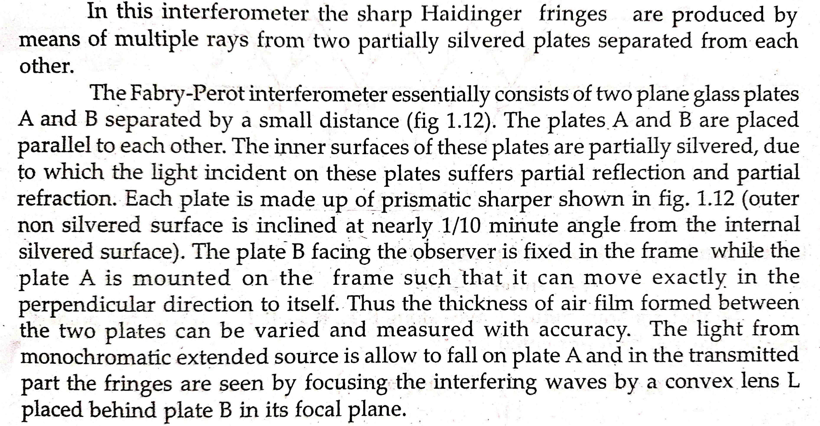
Fabry-Perot Interferometer

Slide 4
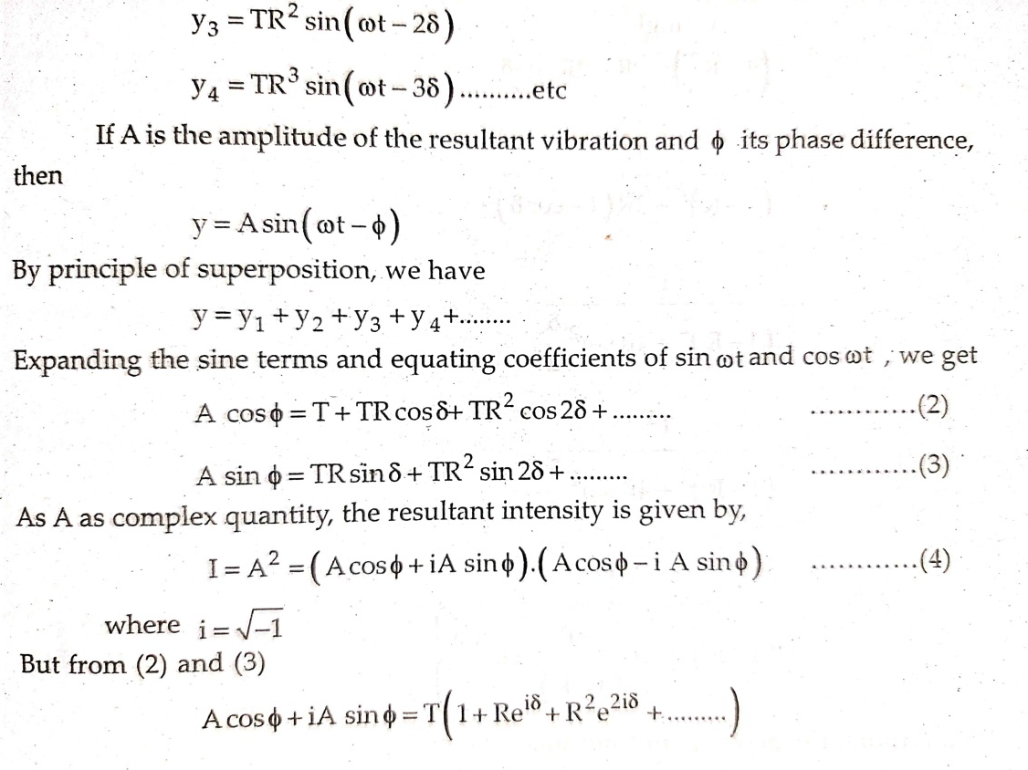

Slide 5
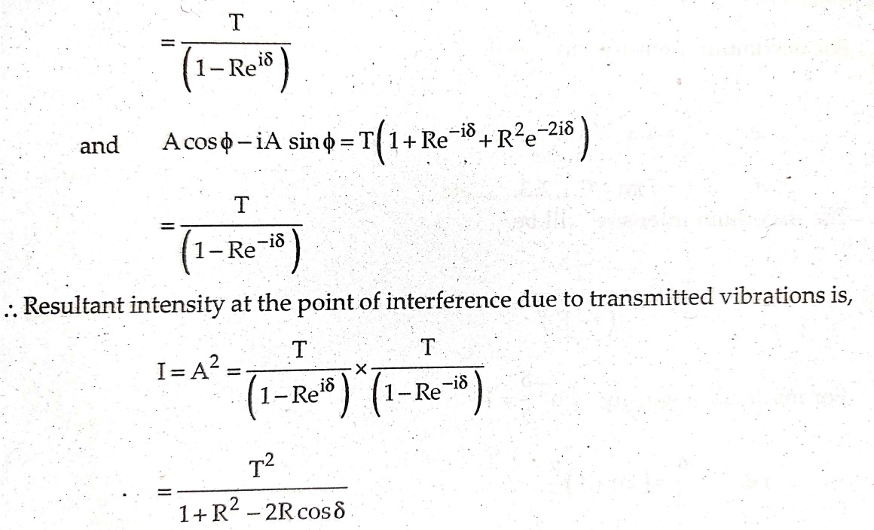

Slide 6
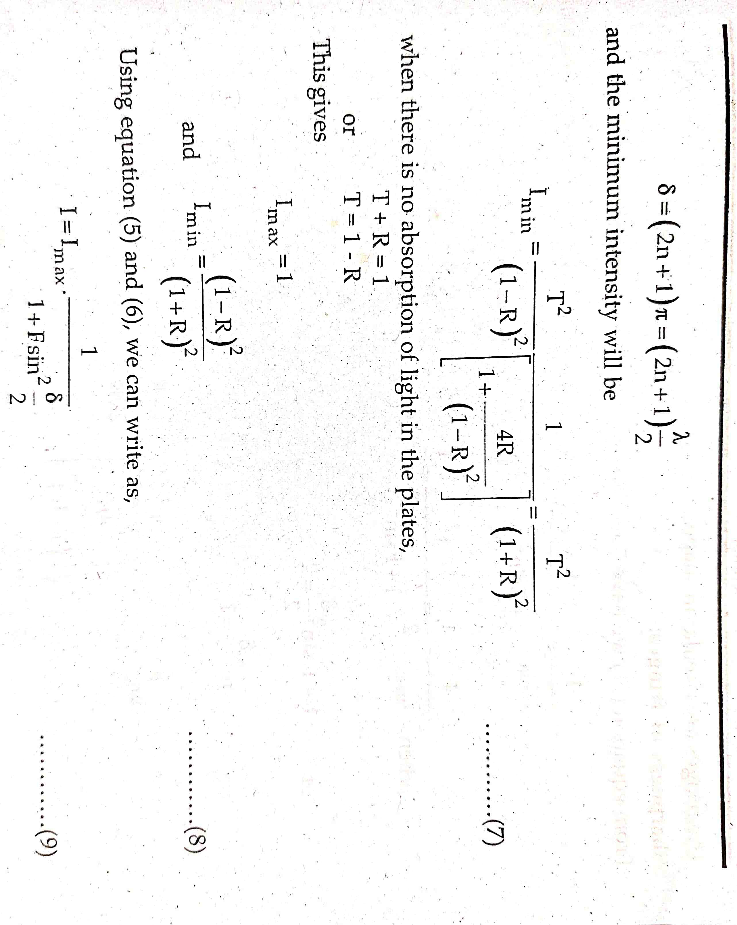

Slide 8
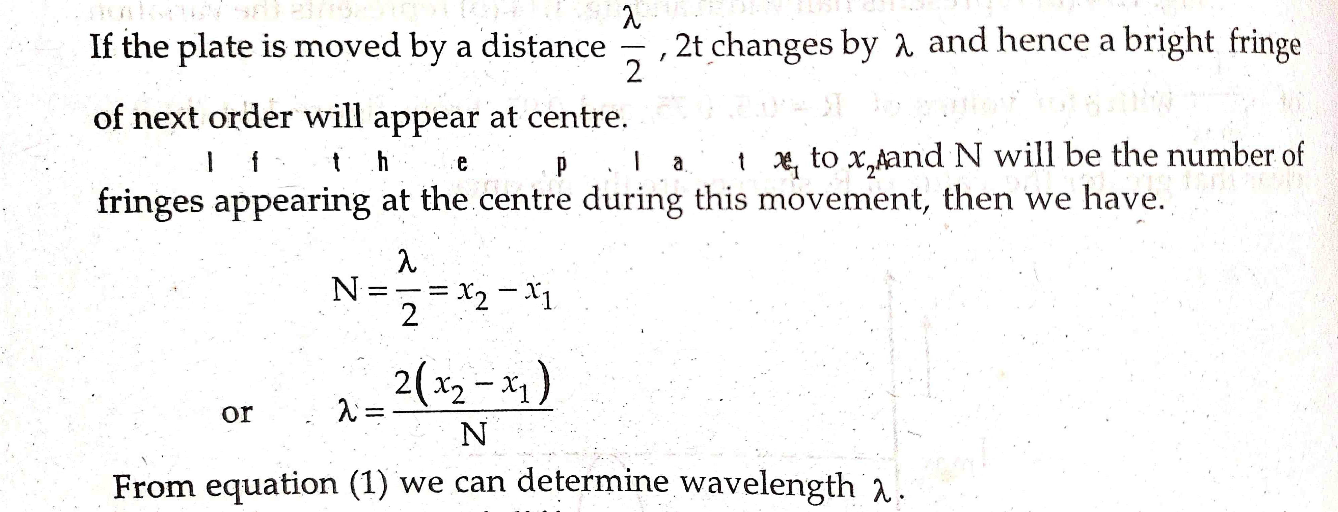
Applications of Fabry-Perot Interferometer

Slide 13
Unit II: Diffraction of Light

Slide 14
The diffraction phenomenon is usually divided into two types 1. Fresnel’s Diffraction 2. Fraunhofer Diffraction
1. Fresnel’s Diffraction

Slide 15
2. Fraunhofer Diffraction

Slide 16
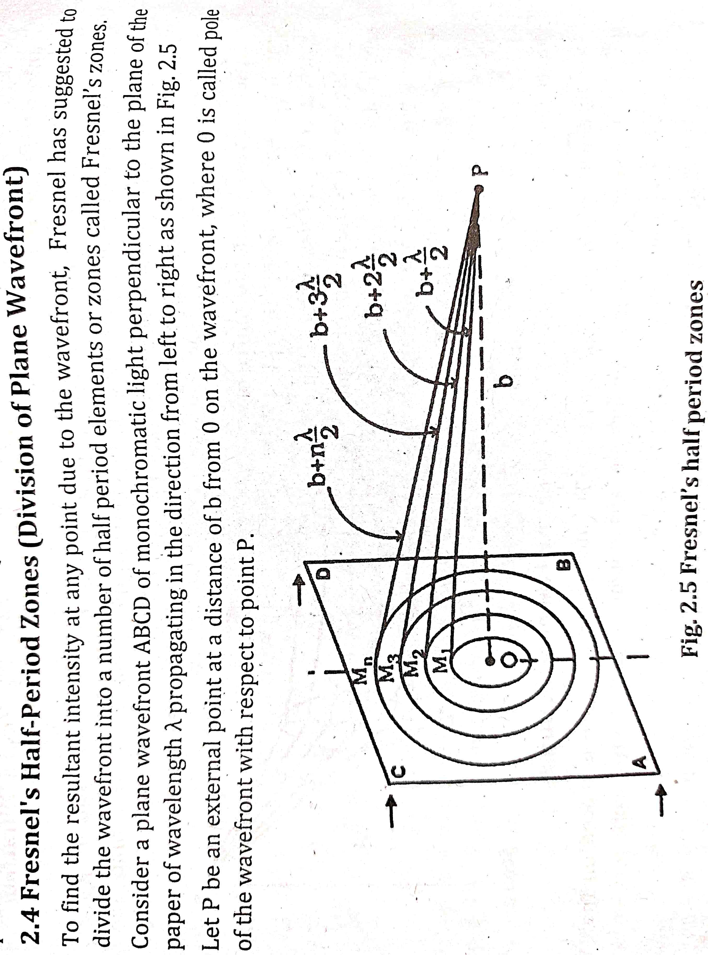
Fresnel’s Half Period Zones (Division of plane wavefront)

Slide 17
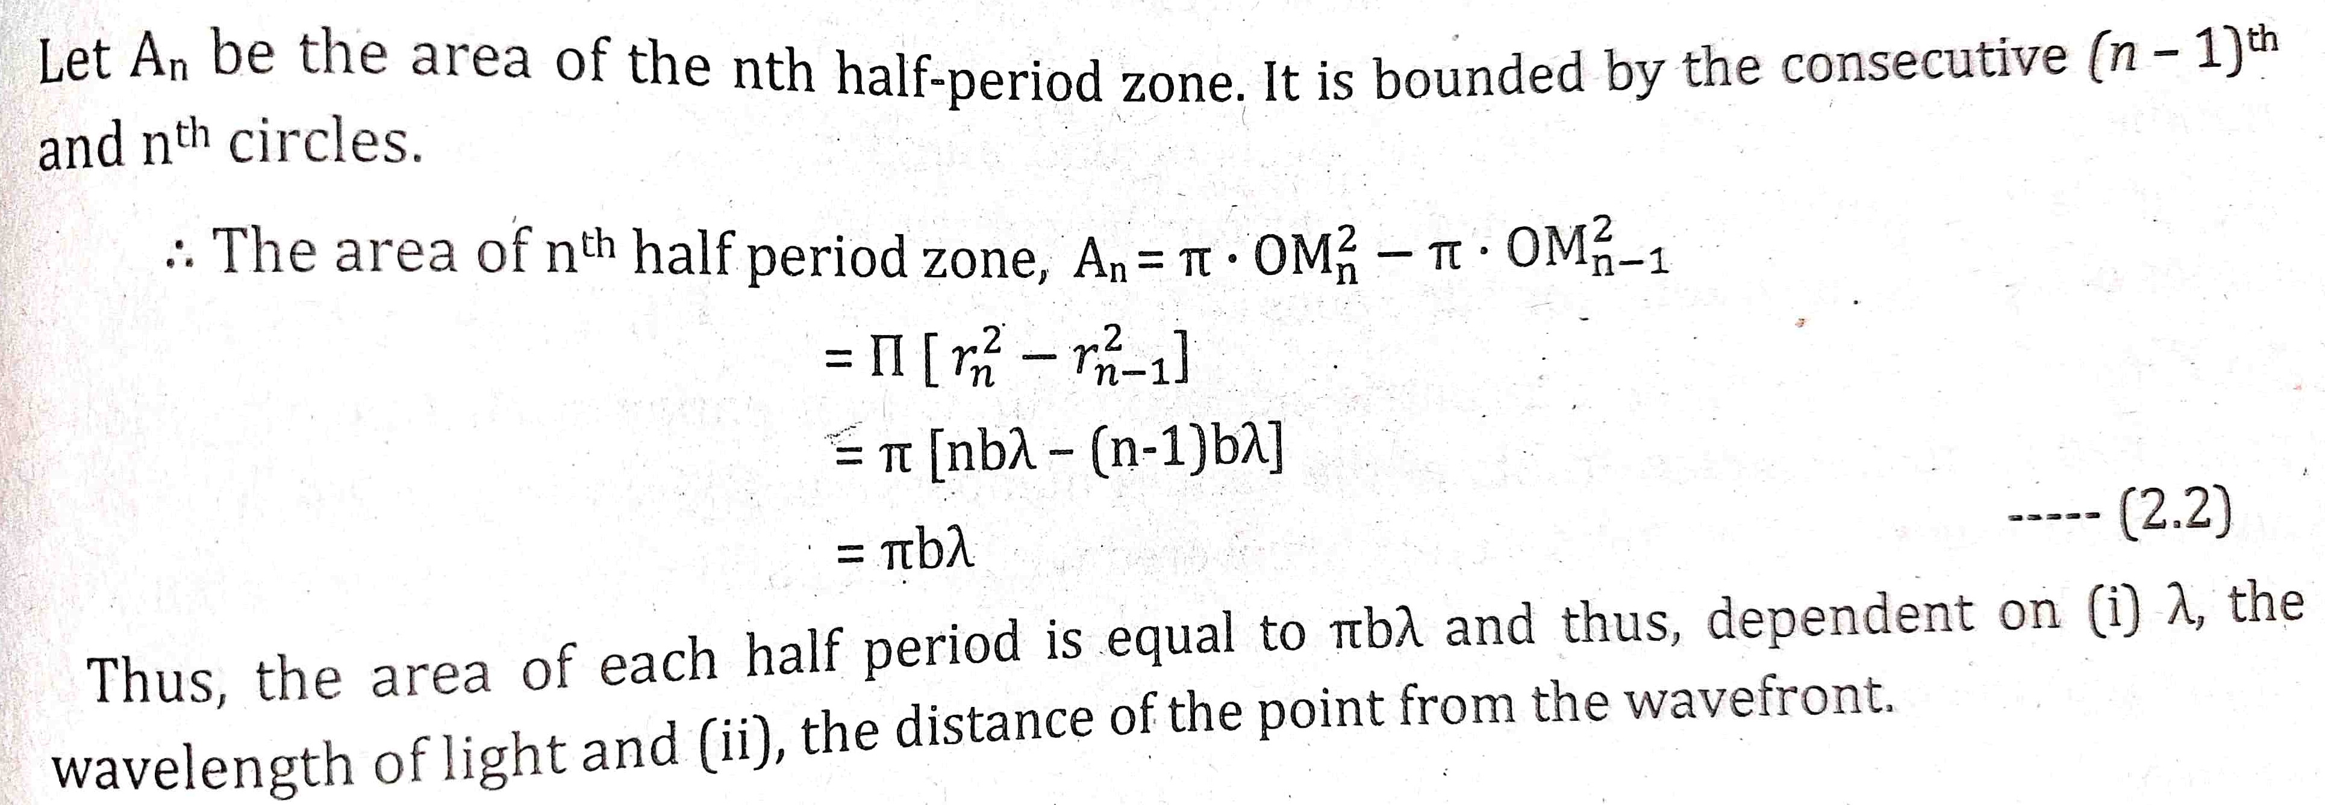
Radius of Half Period Zones
Area of Half Period Zones

Slide 18
Zone Plate

Slide 19
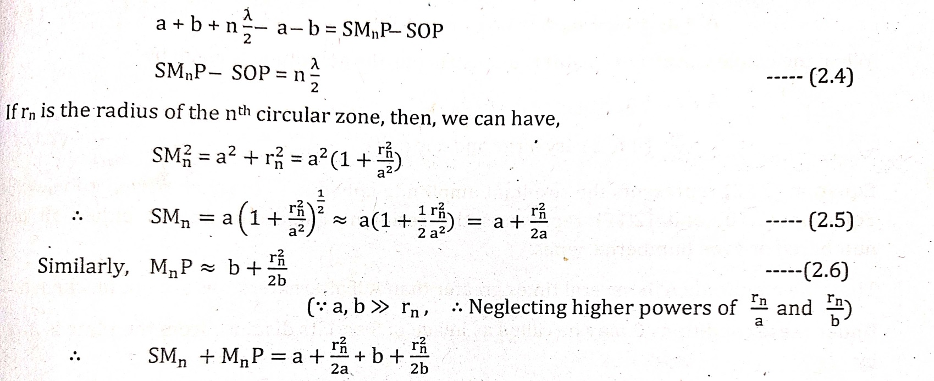

Slide 21
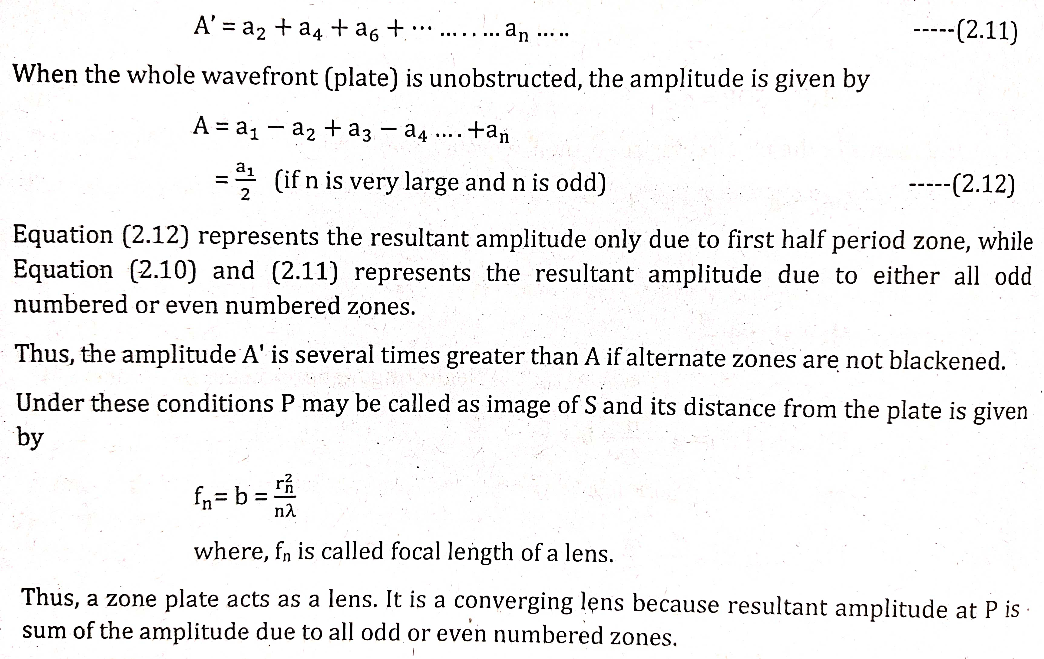
Working of Zone Plate as a Lens

Slide 23
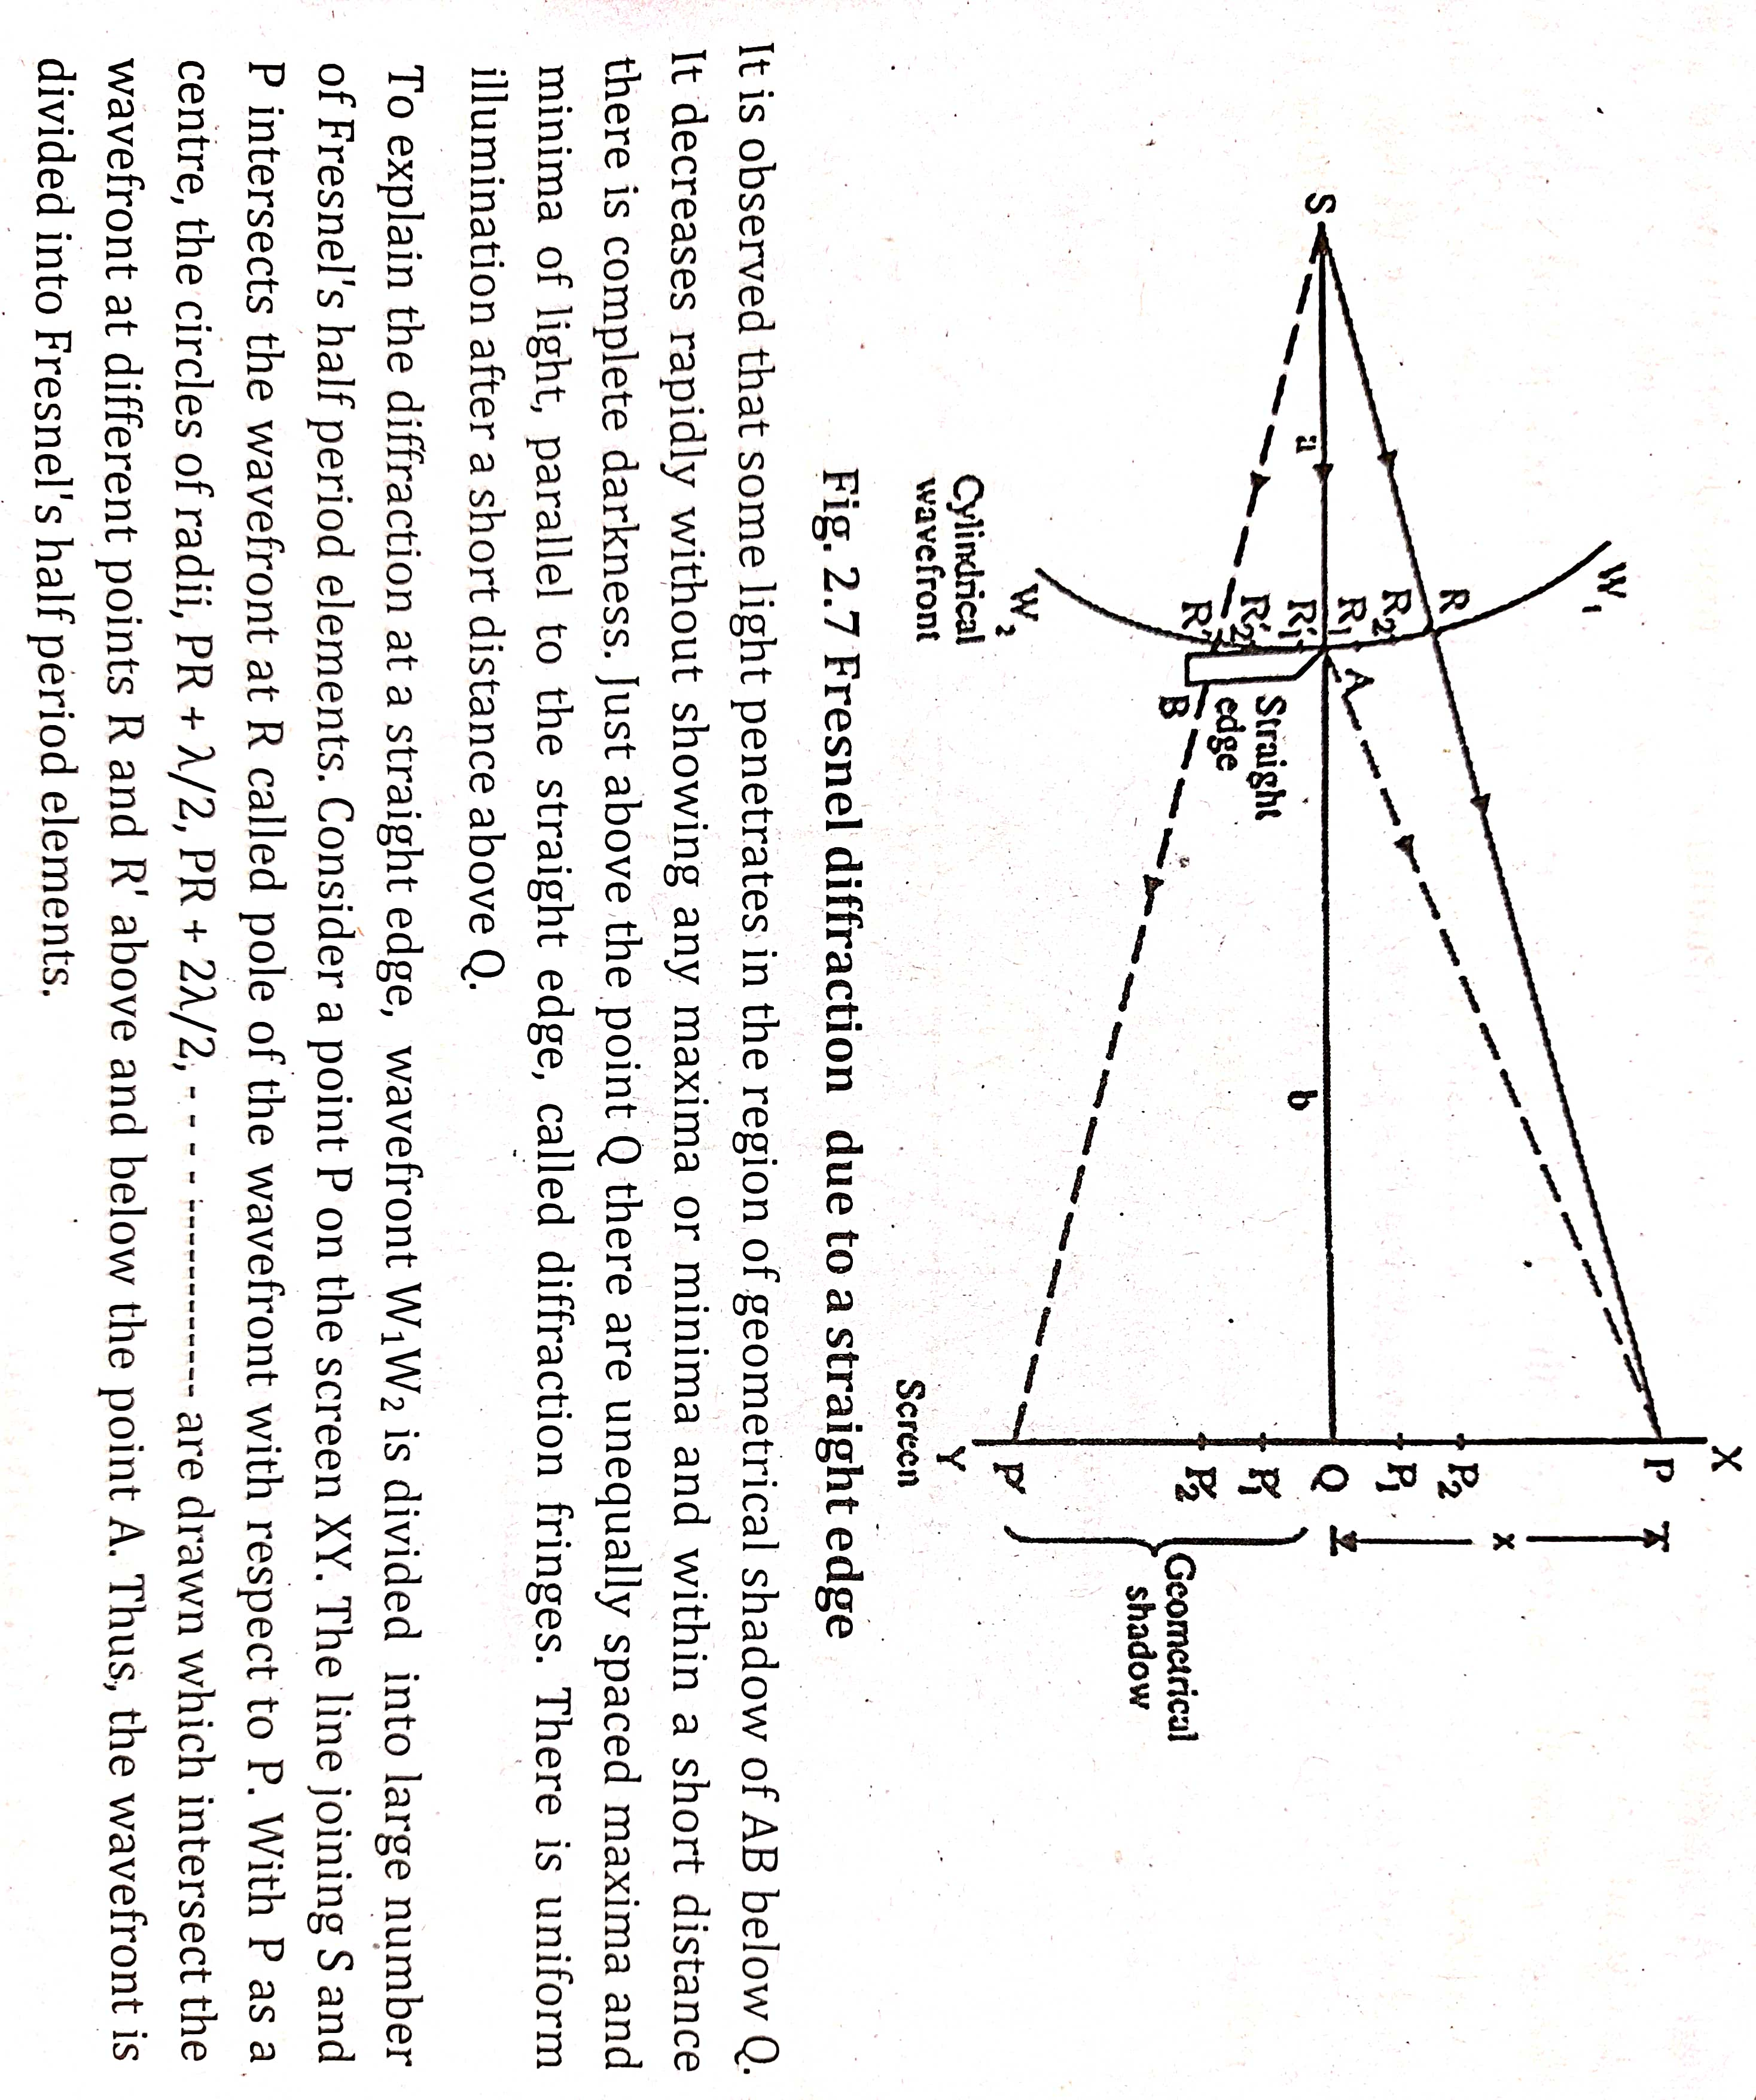

Slide 24
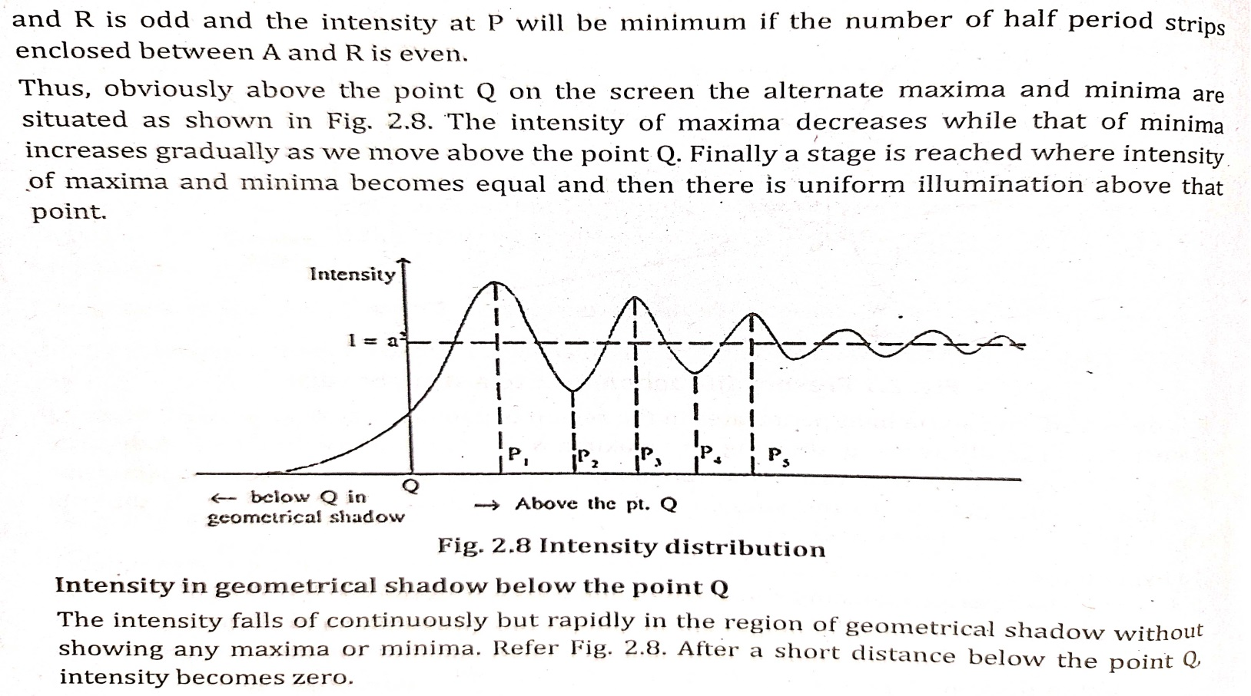

Slide 25
Fresnel’s Diffraction due to Narrow Slit

Slide 26
Fresnel’s Diffraction due to Narrow Slit continued..

Slide 27
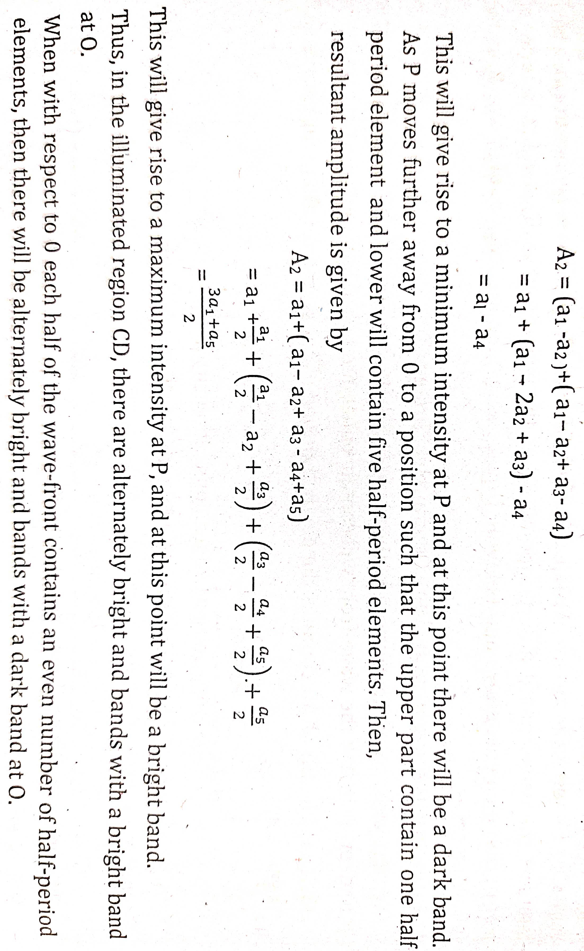

Slide 29
Fraunhofer diffraction at a single Slit
Consider a narrow slit AB of width a perpendicular to plane of the paper. A parallel beam of monochromatic light of wavelength λ is incident normally on a slit

Slide 30
Fraunhofer diffraction at a single Slit

Slide 31
Fraunhofer diffraction at a single Slit

Slide 32
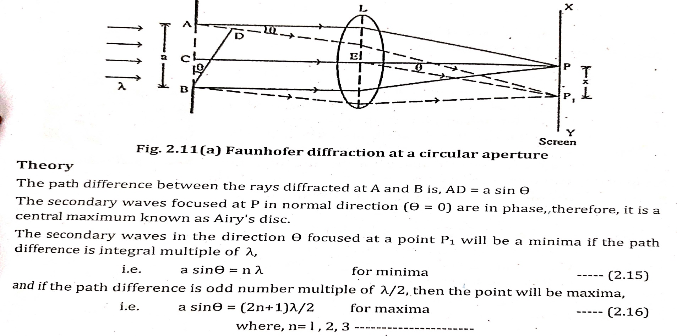
Fraunhofer diffraction at a circular aperture

Slide 33
Fraunhofer diffraction at a circular aperture

Slide 34
Fraunhofer diffraction at a circular aperture

Slide 35
Plane Diffraction Grating

Slide 36
Plane Diffraction Grating

Slide 37
Plane Diffraction Grating

Slide 38
Plane Diffraction Grating

Slide 39
Plane Diffraction Grating

Slide 40
Plane Diffraction Grating

Slide 41
Plane Diffraction Grating

Slide 42
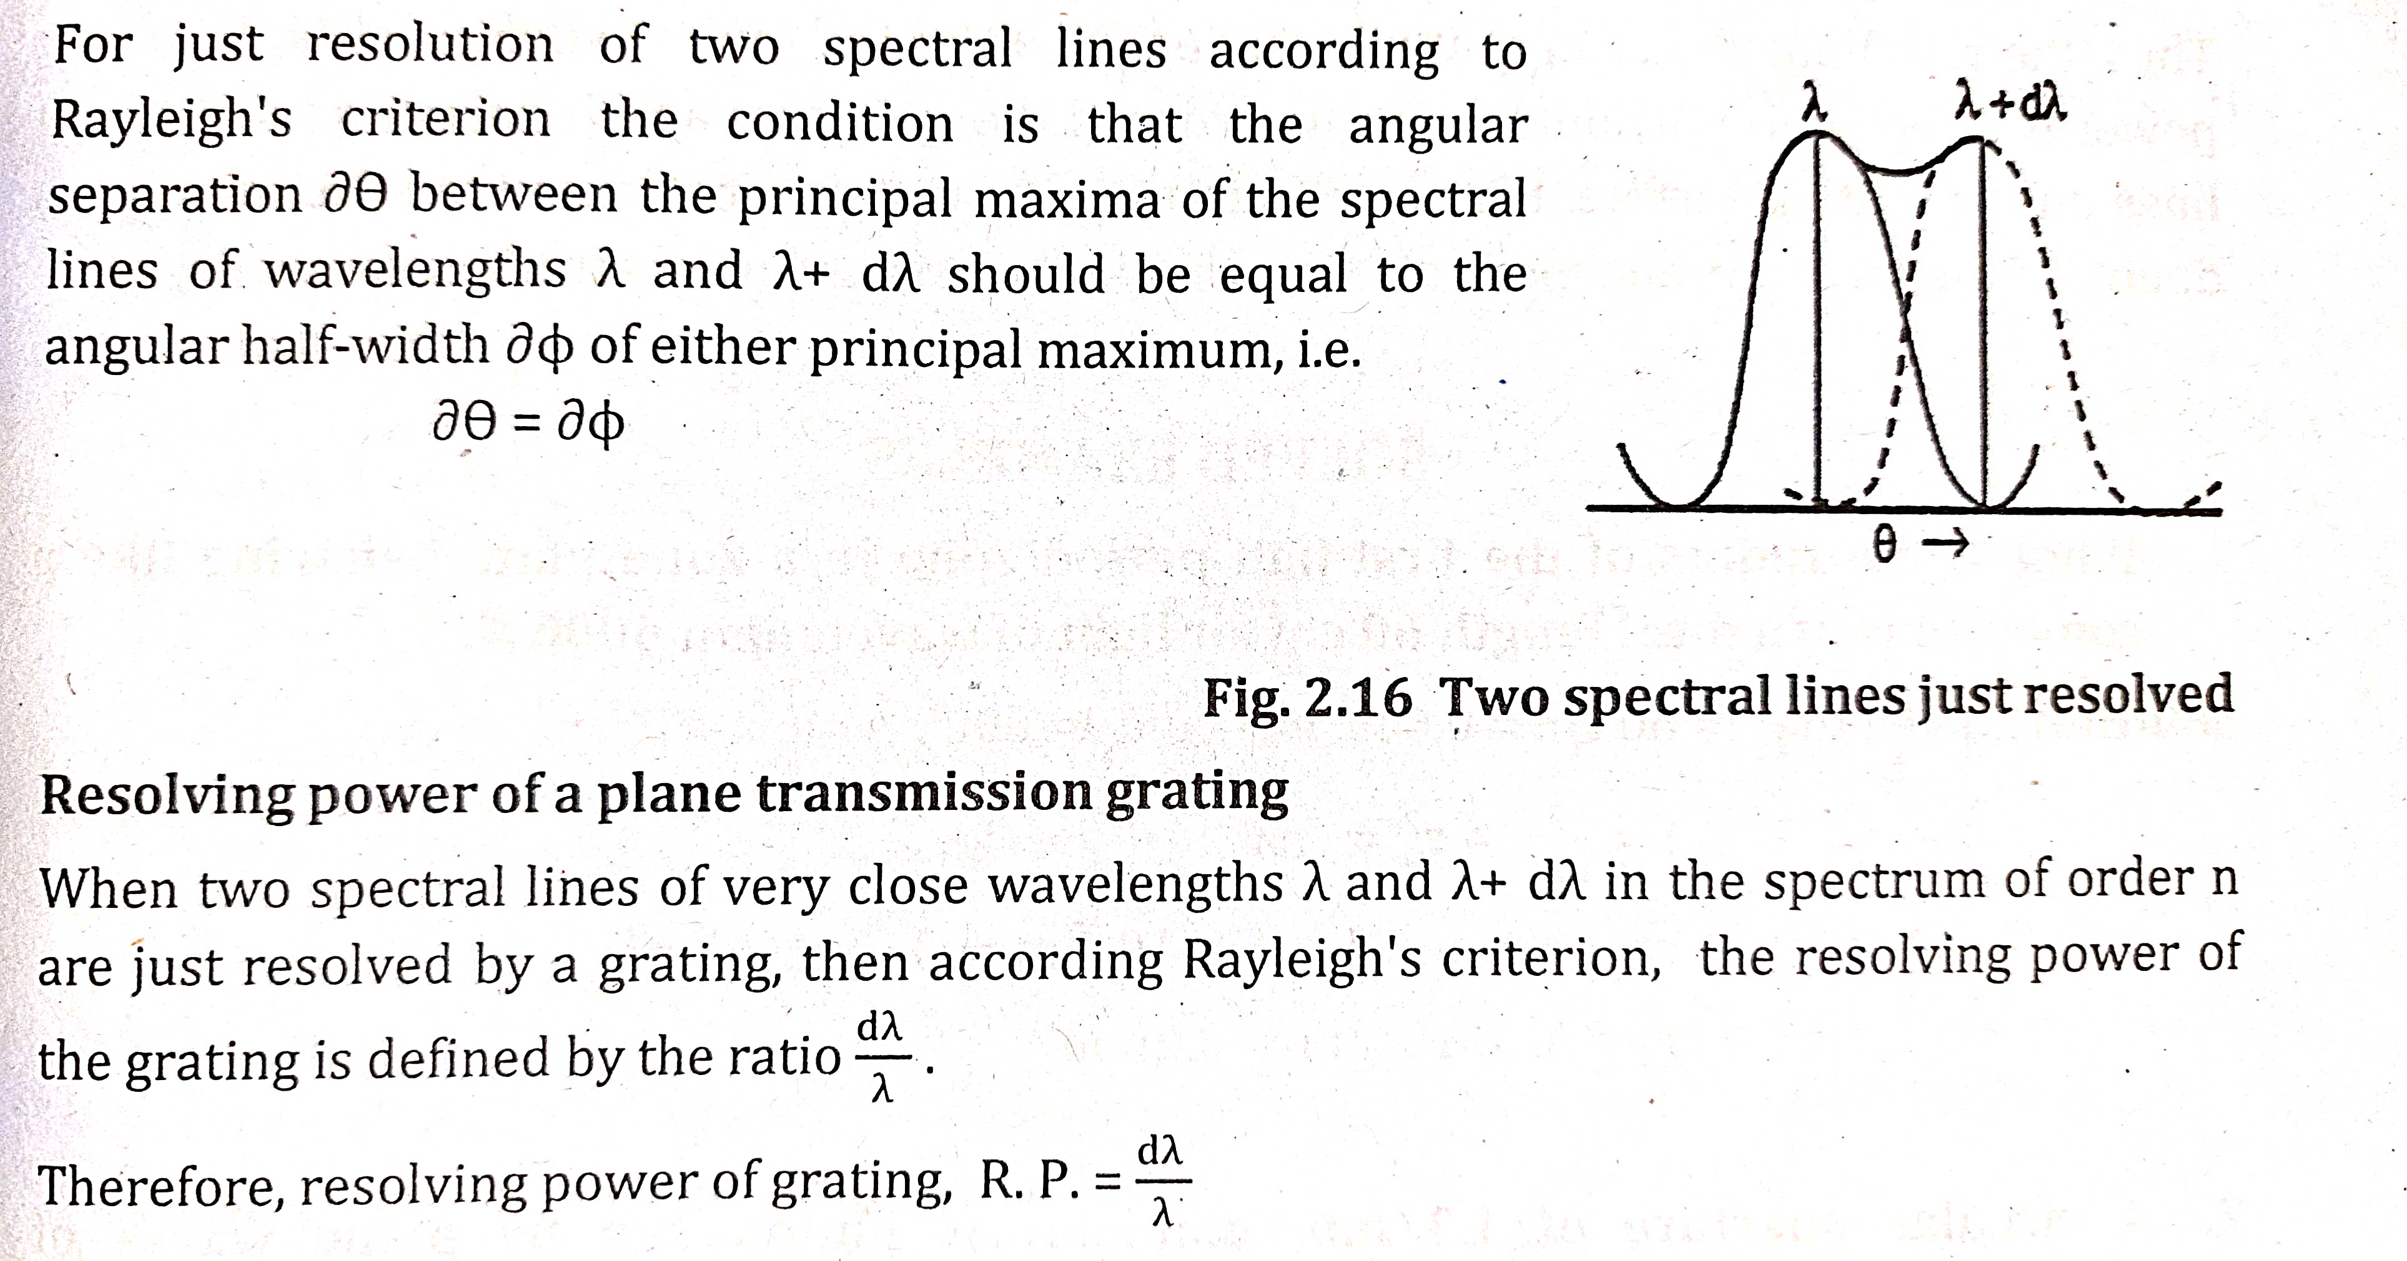
Resolving Power

Slide 43
Resolving Power of Plane Transmission Grating

Slide 44
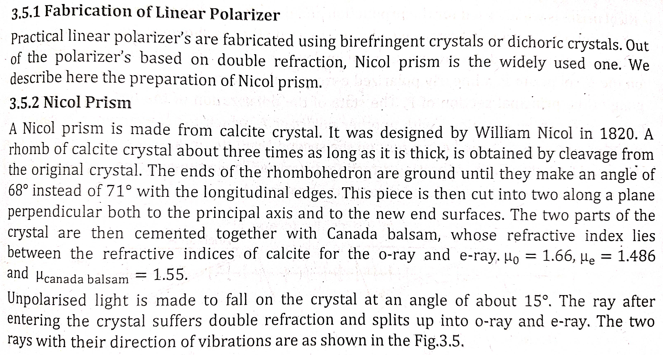
Unit III: Polarization of Light

Slide 45
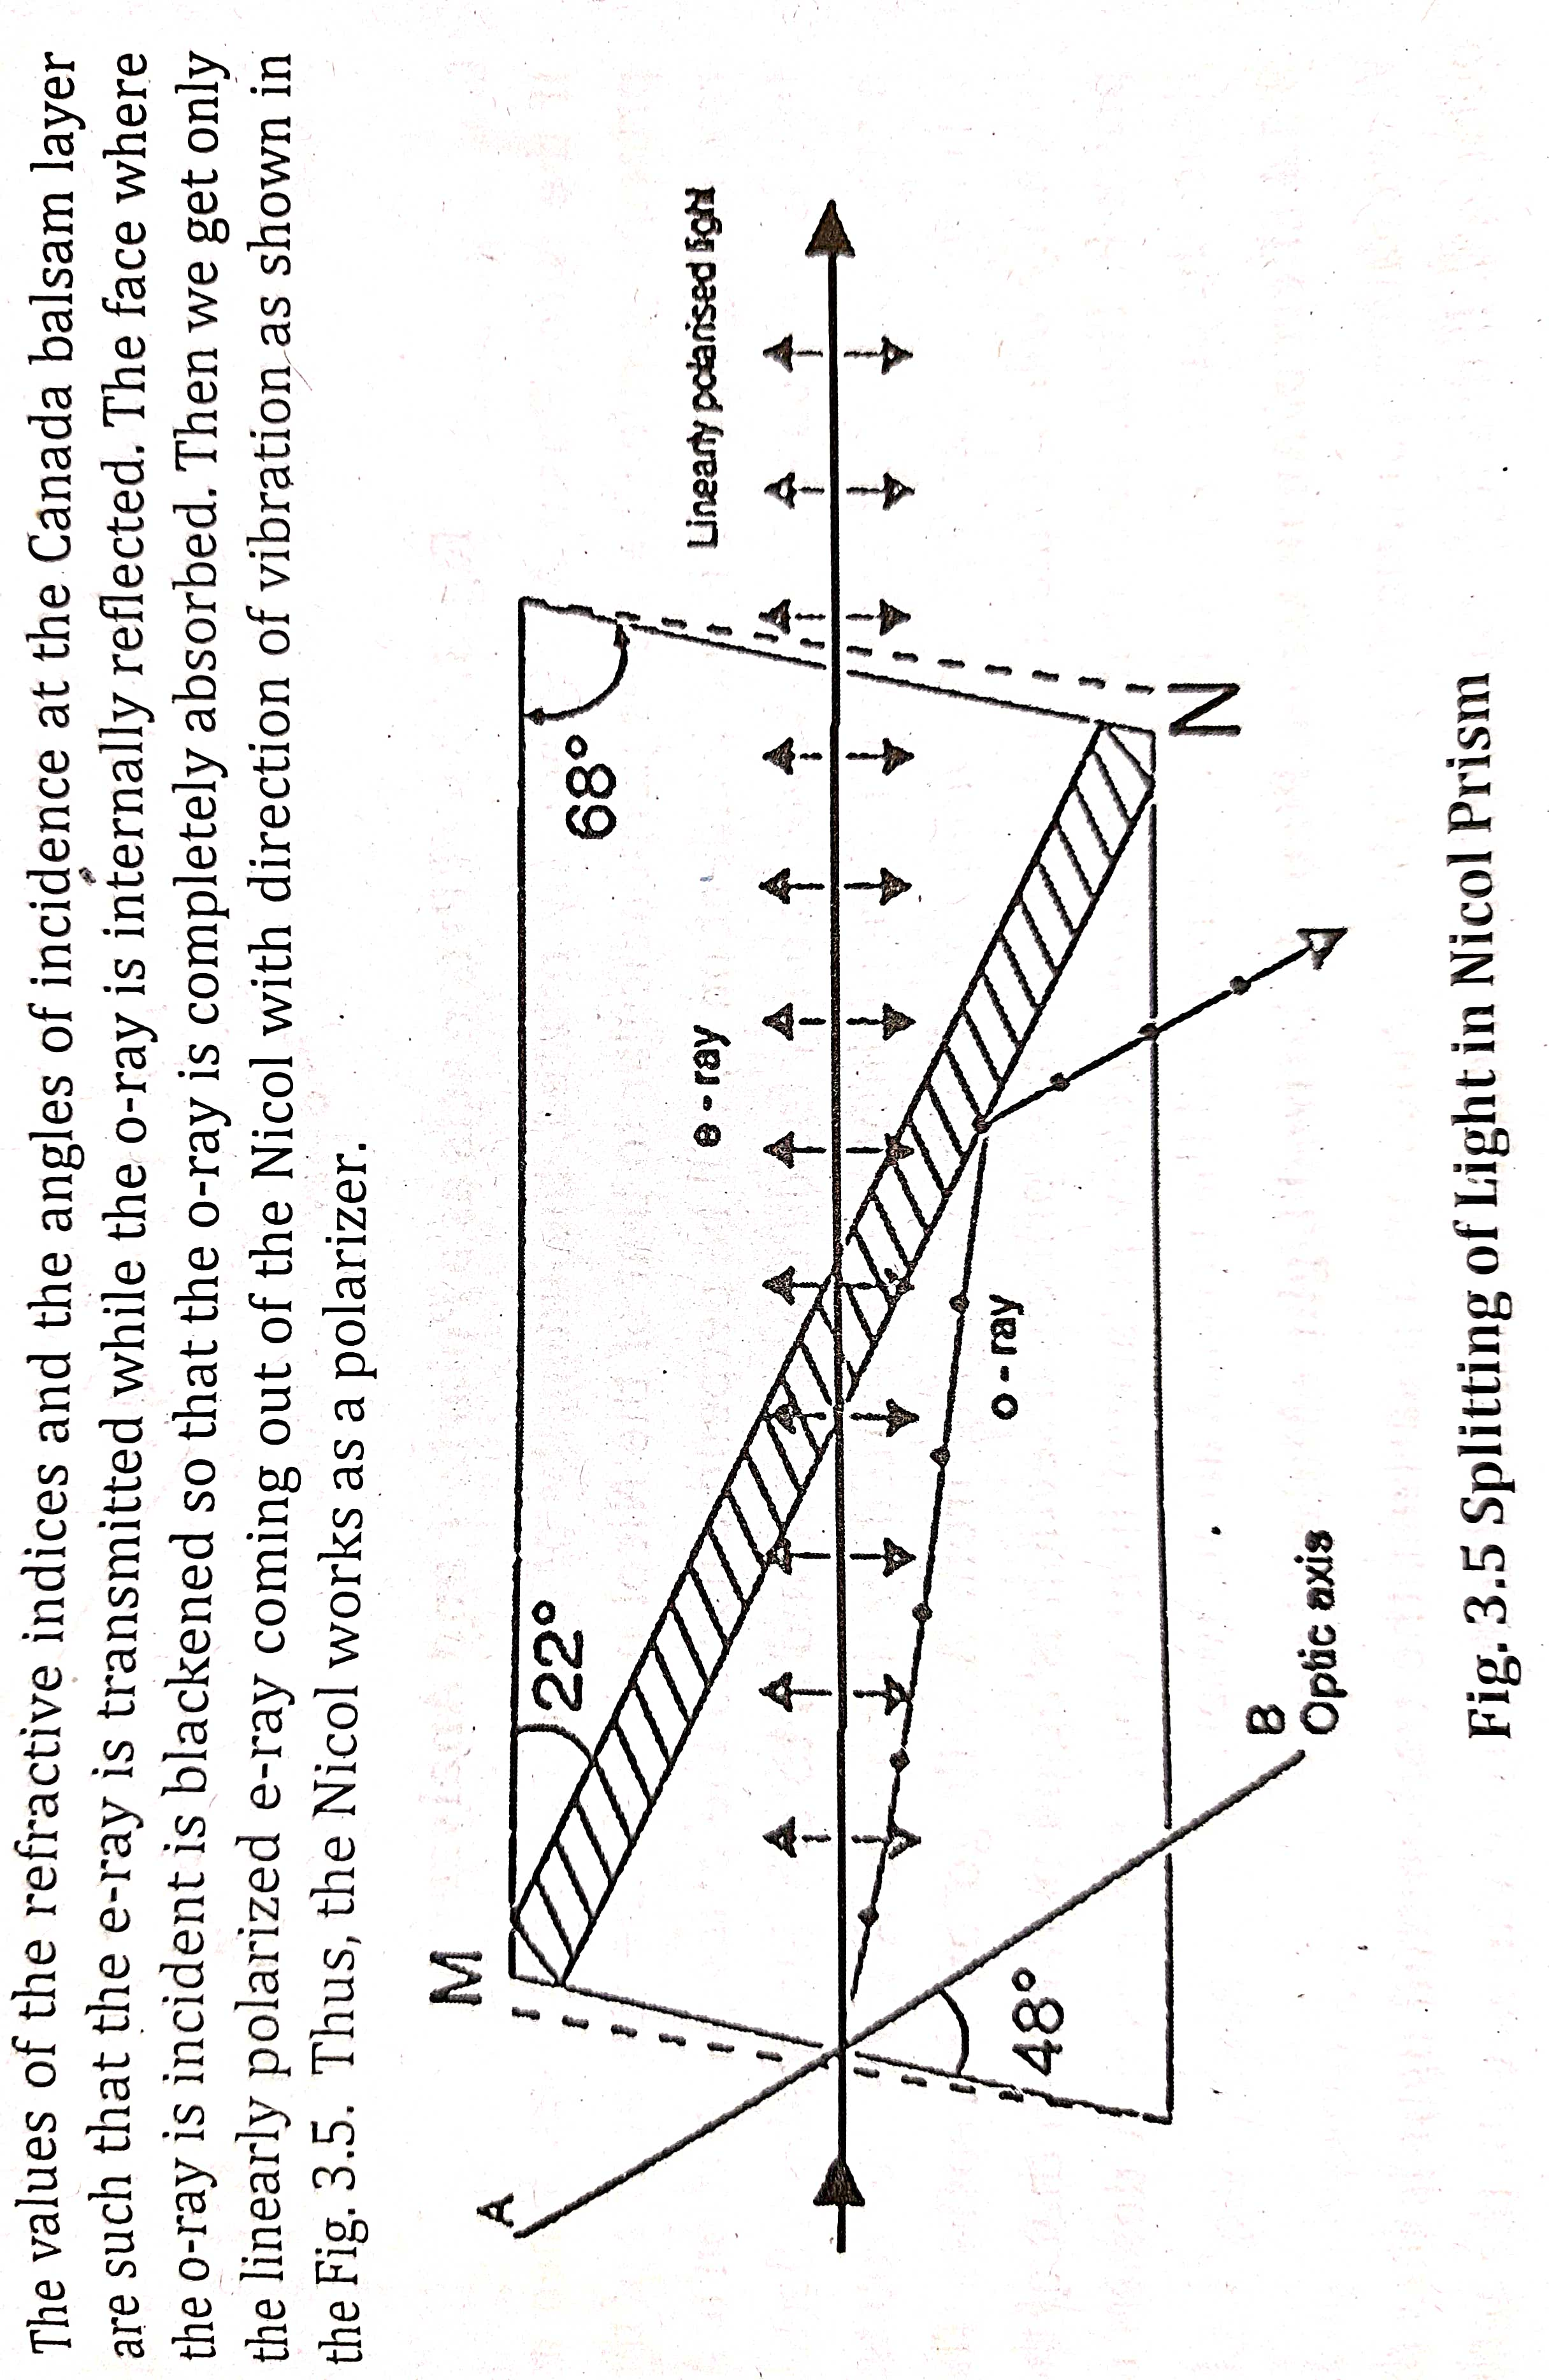

Slide 46
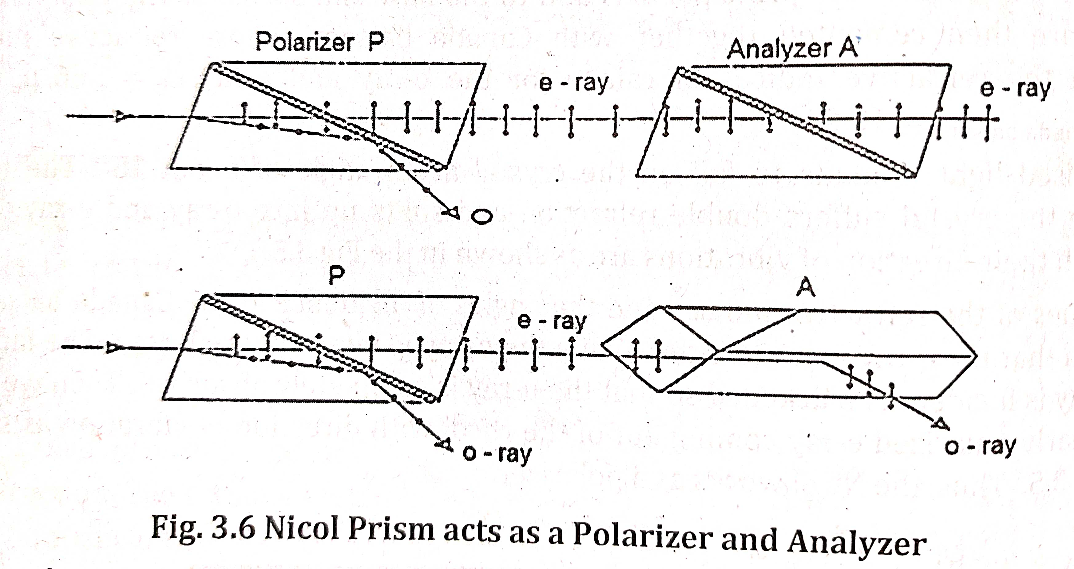
Working of Nicol Prism

Slide 47
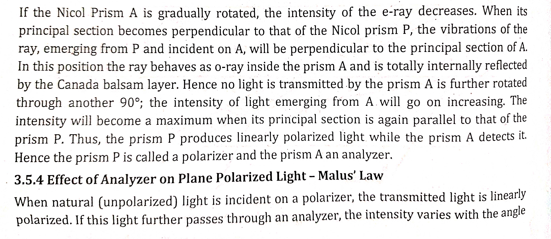
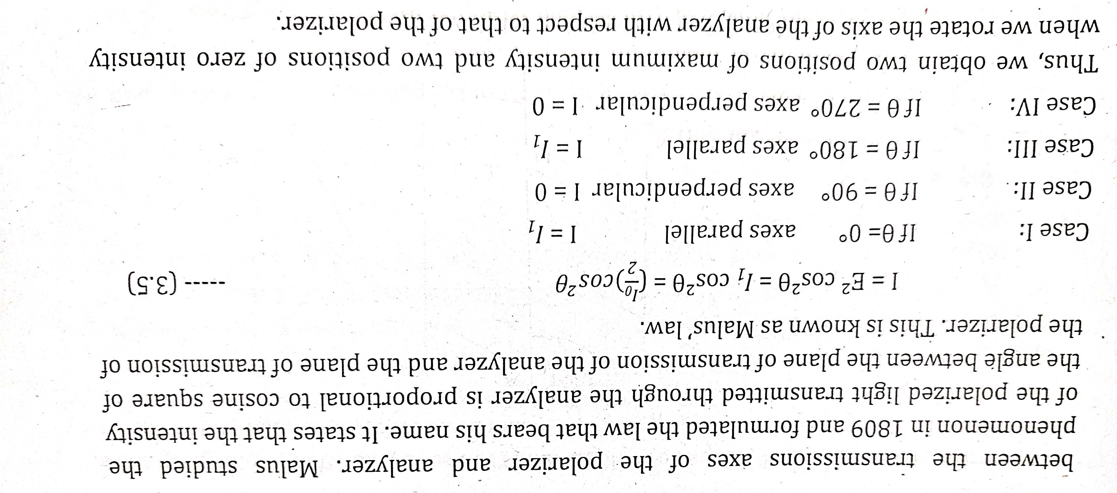

Slide 48
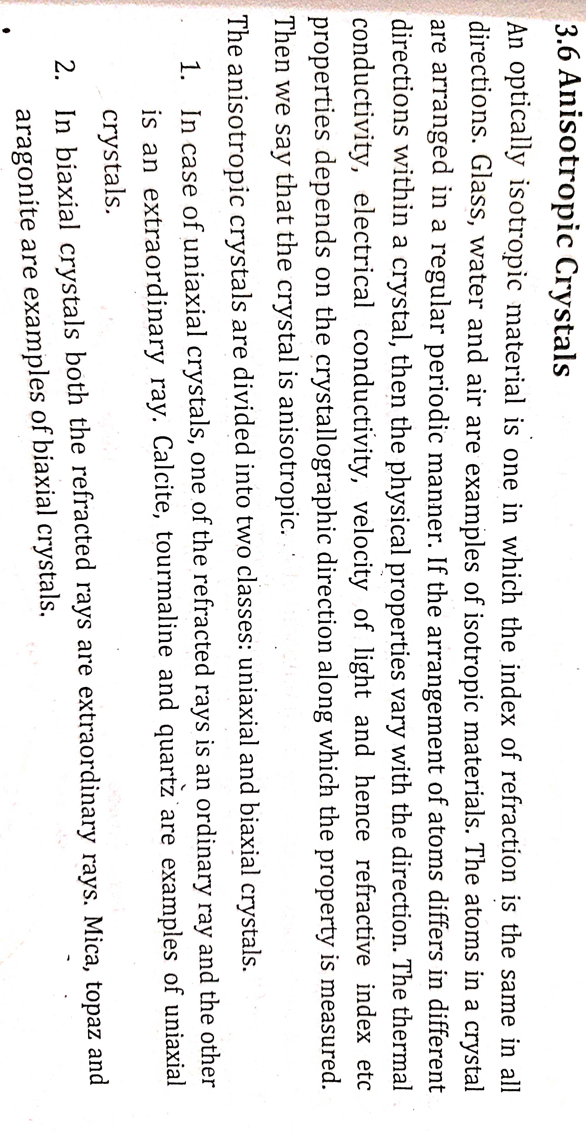
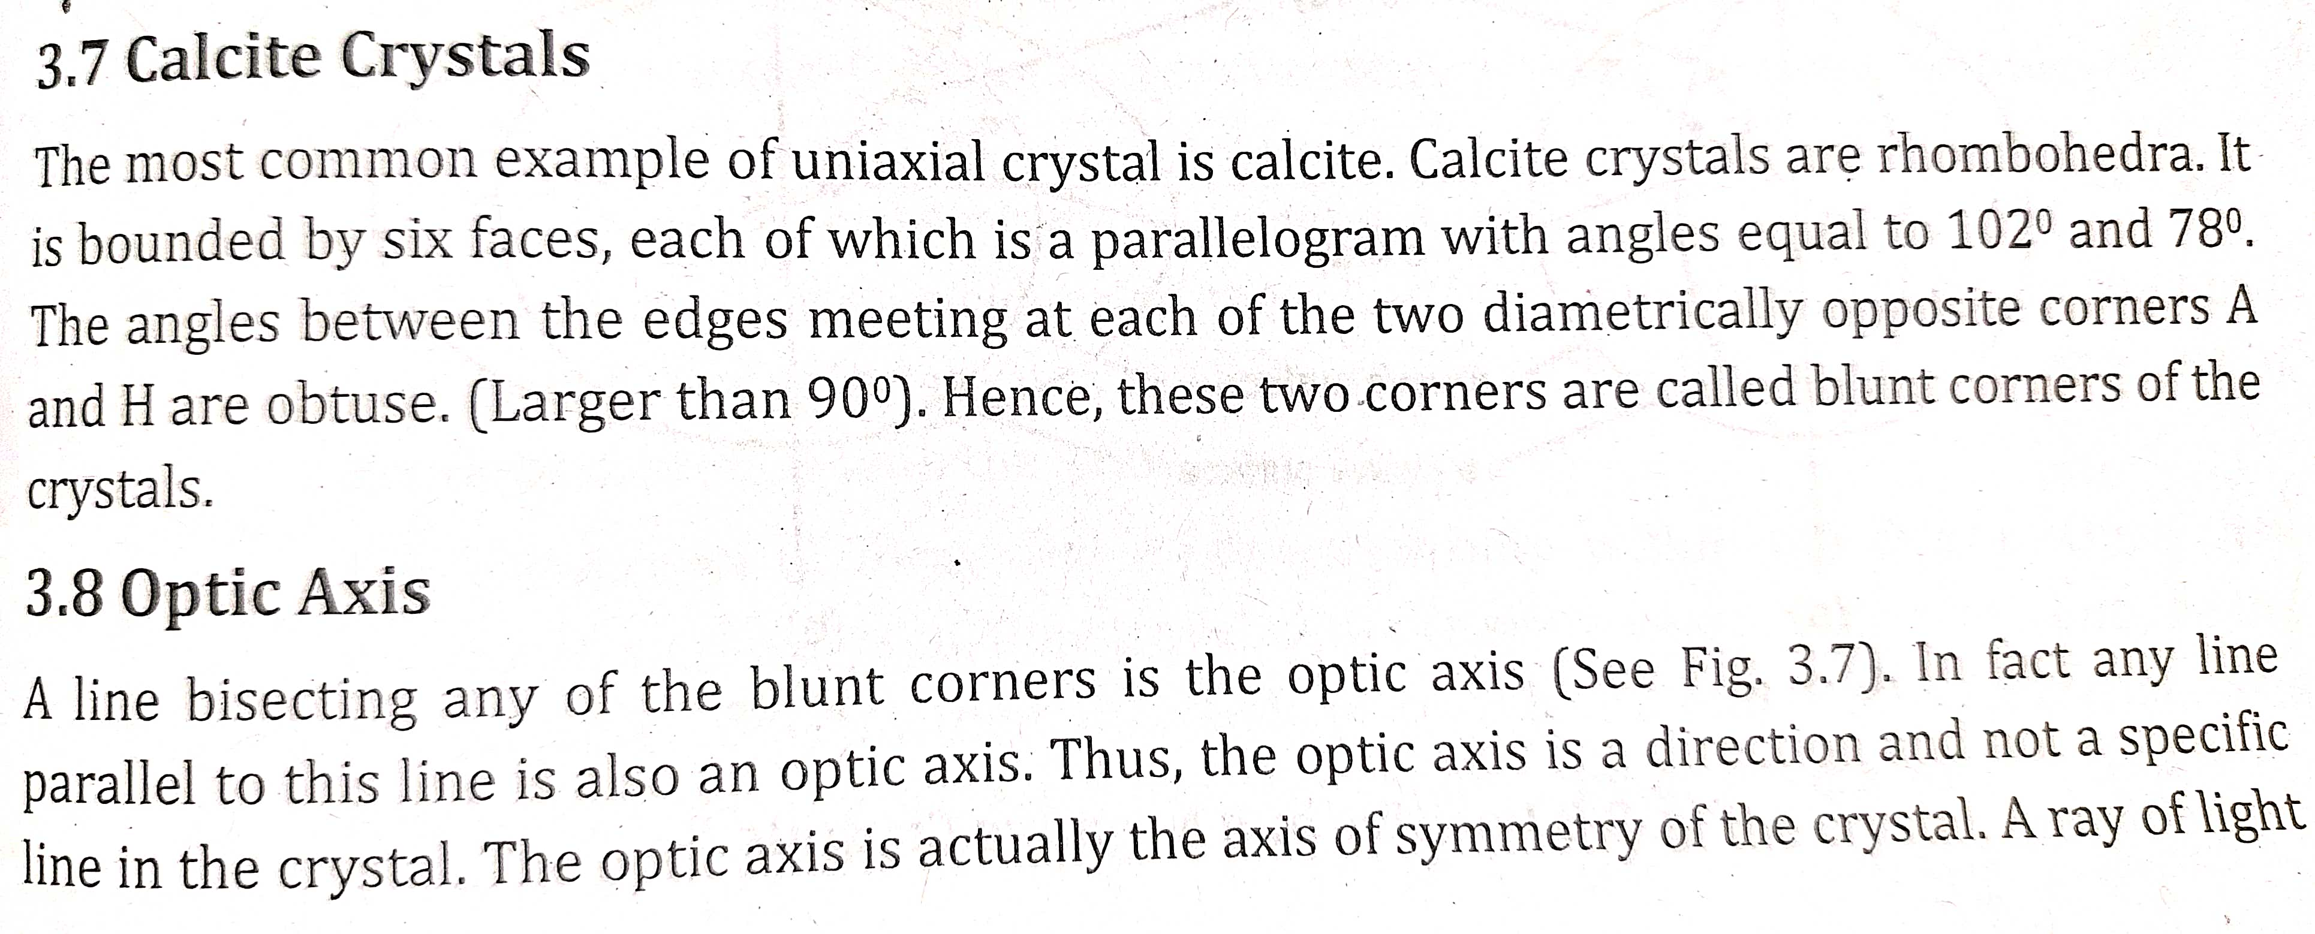

Slide 49
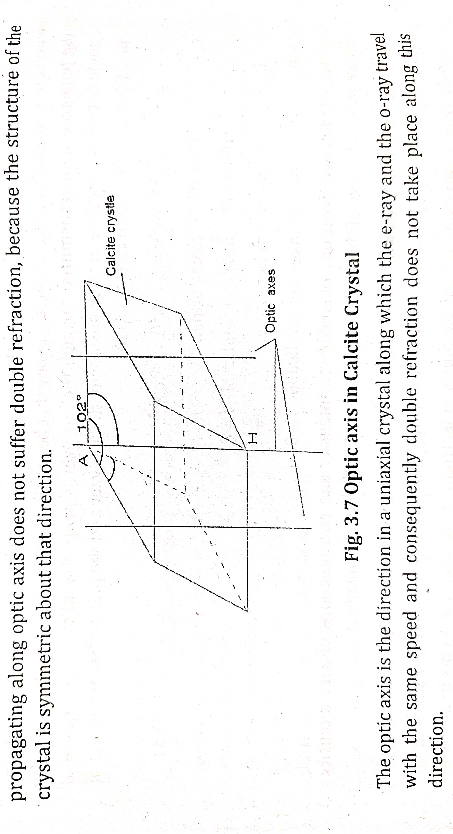

Slide 50
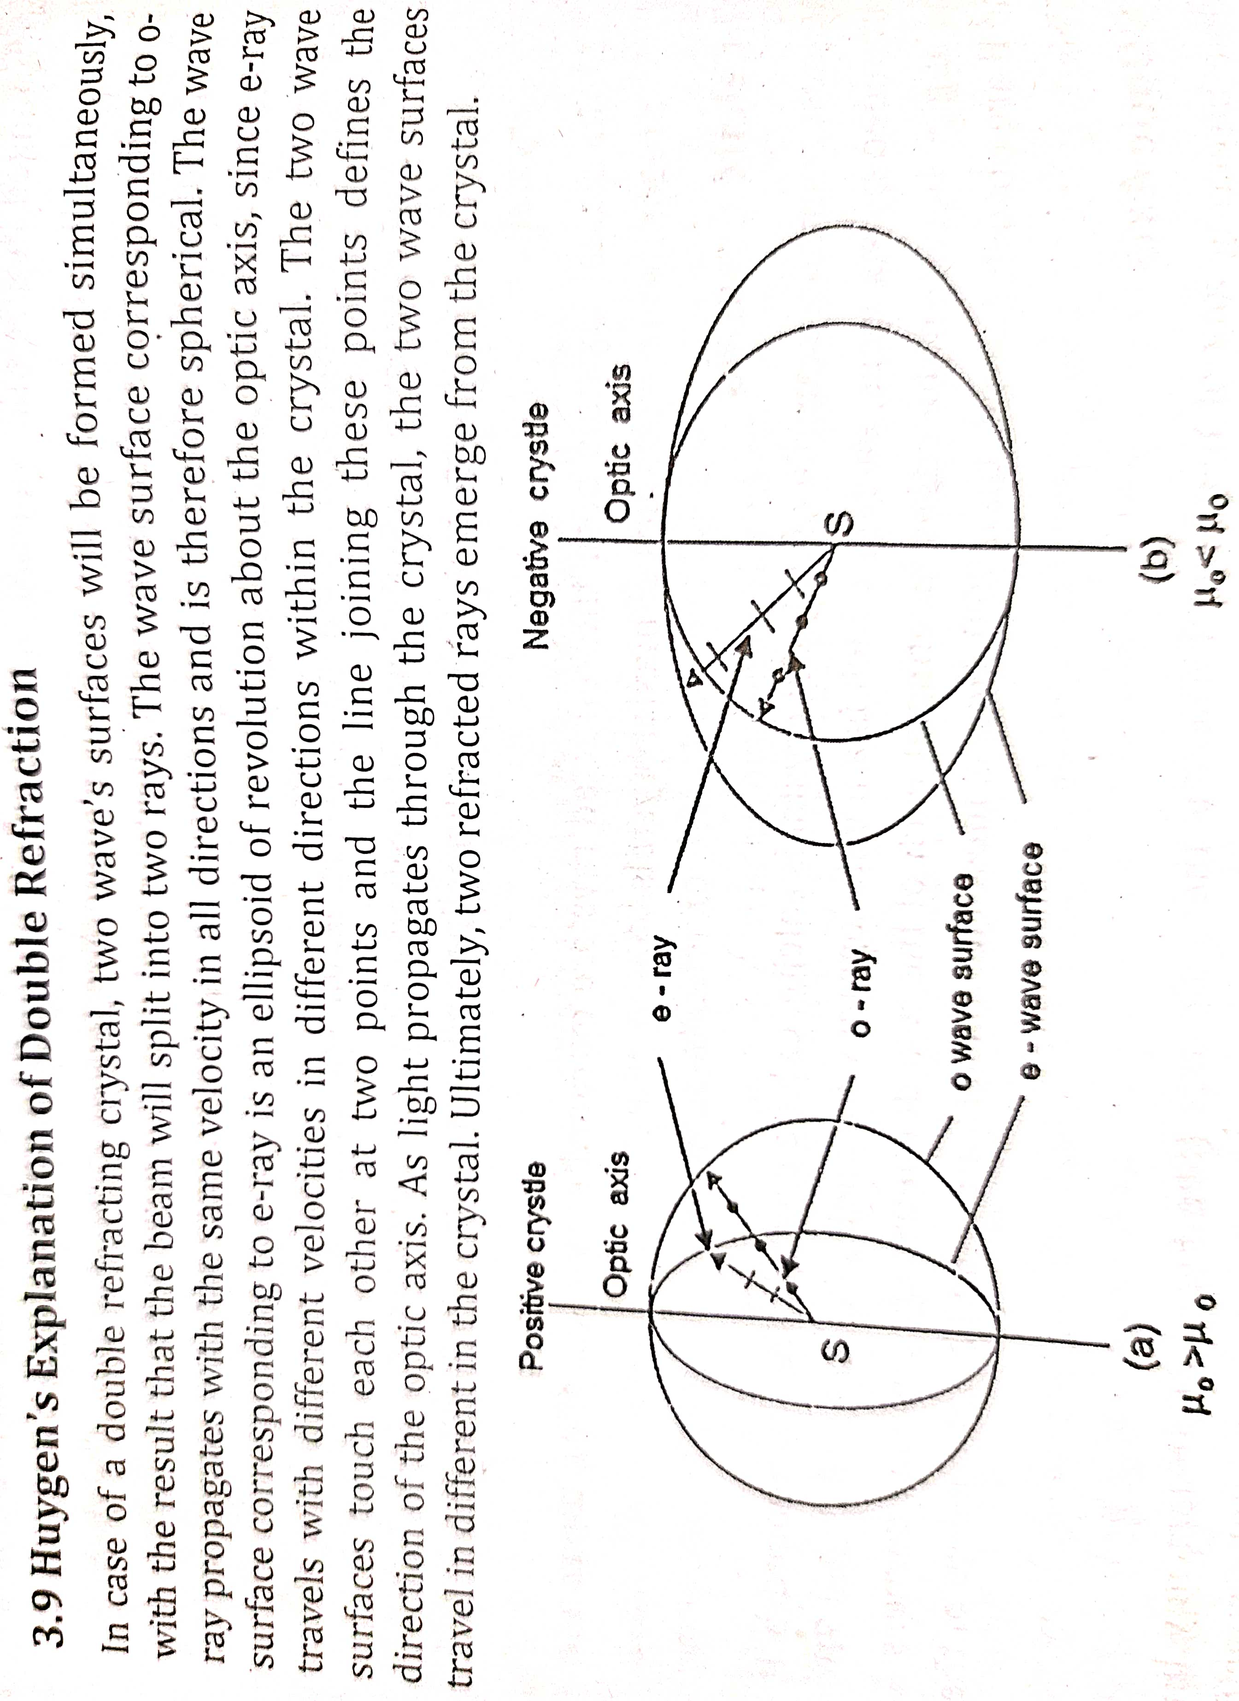

Slide 51
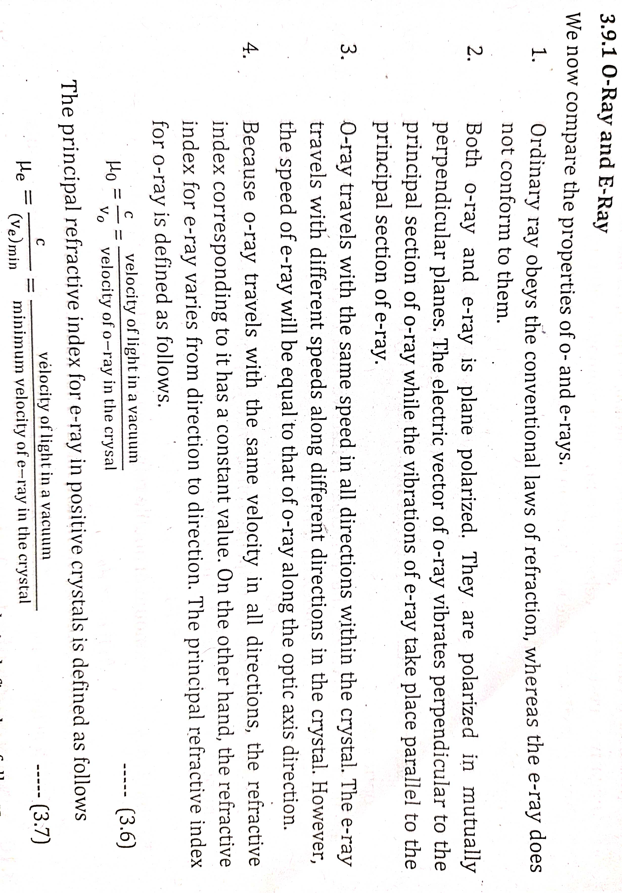

Slide 52
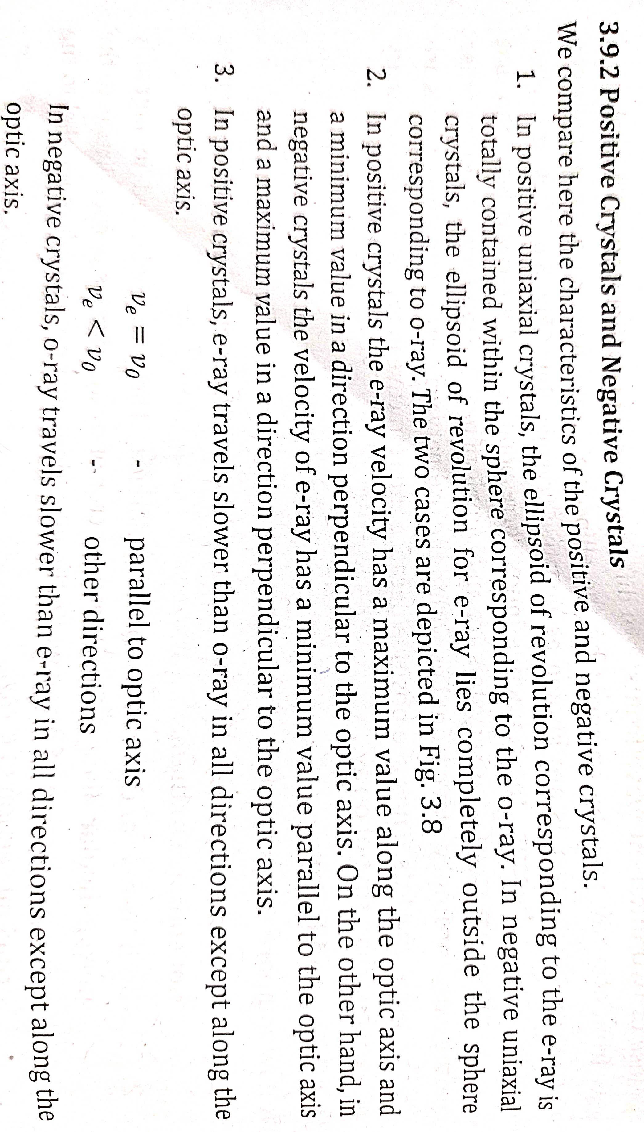
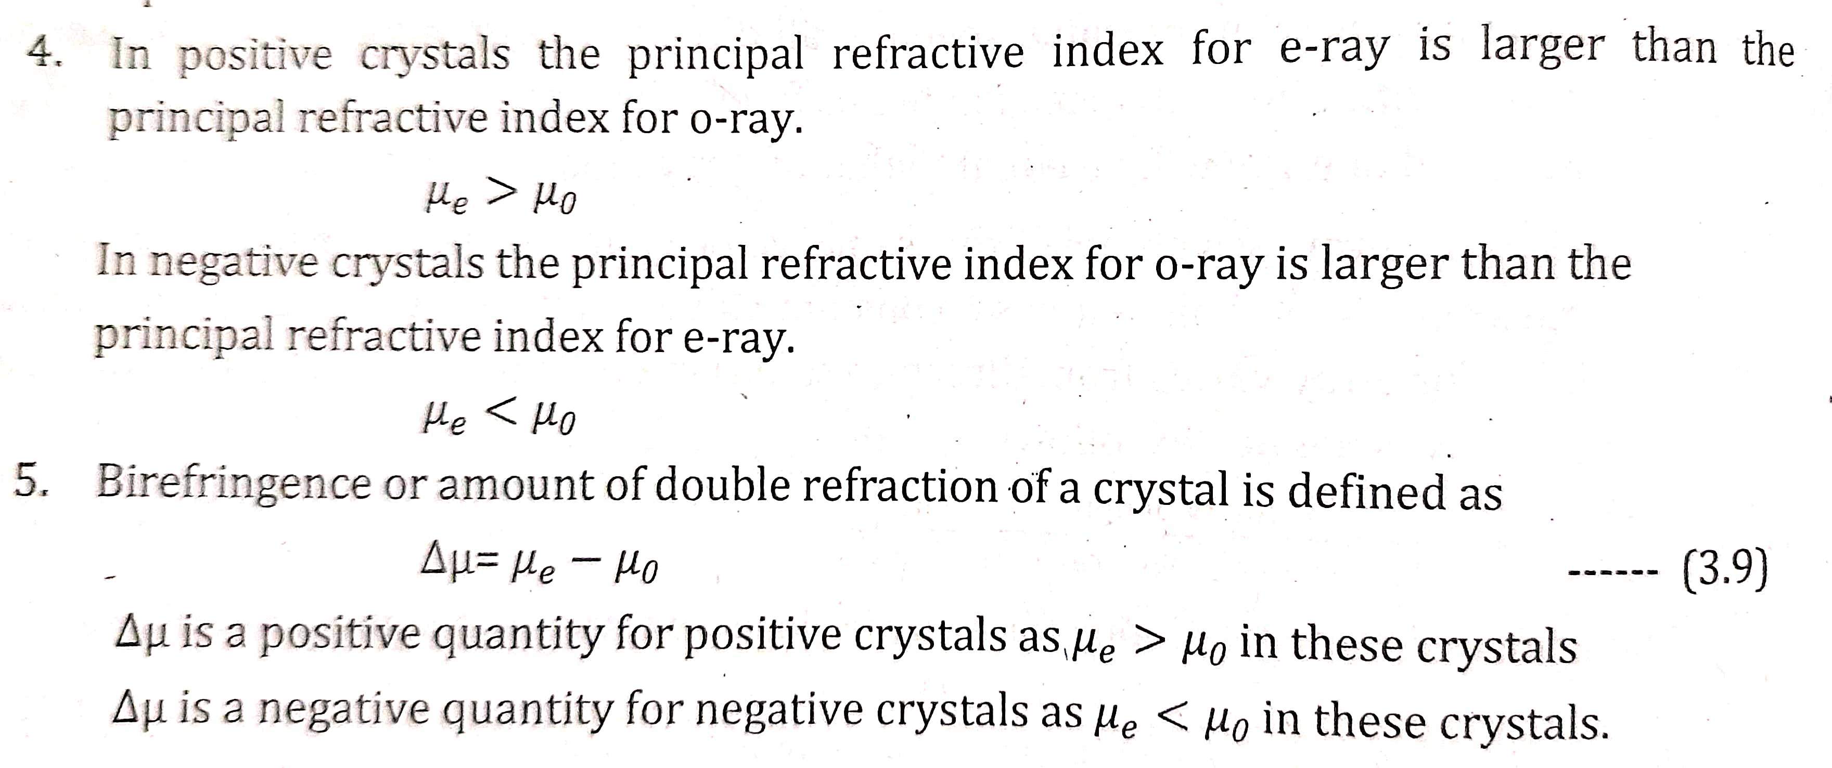

Slide 53
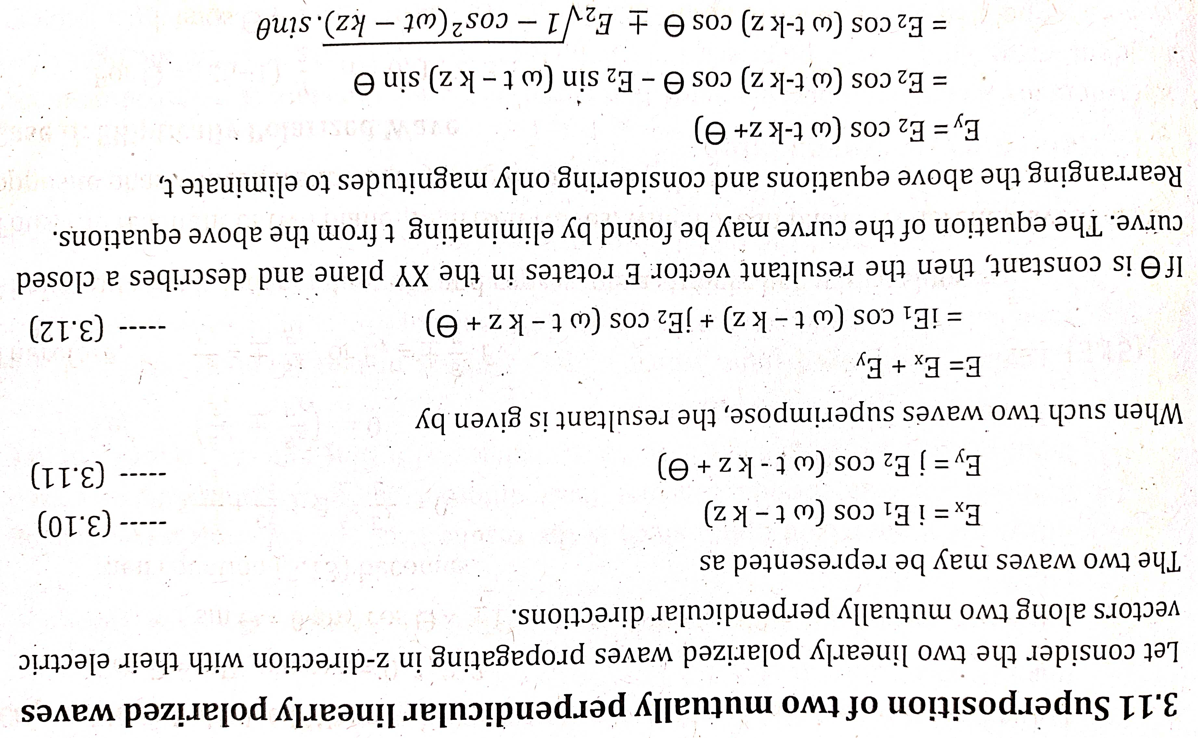

Slide 54
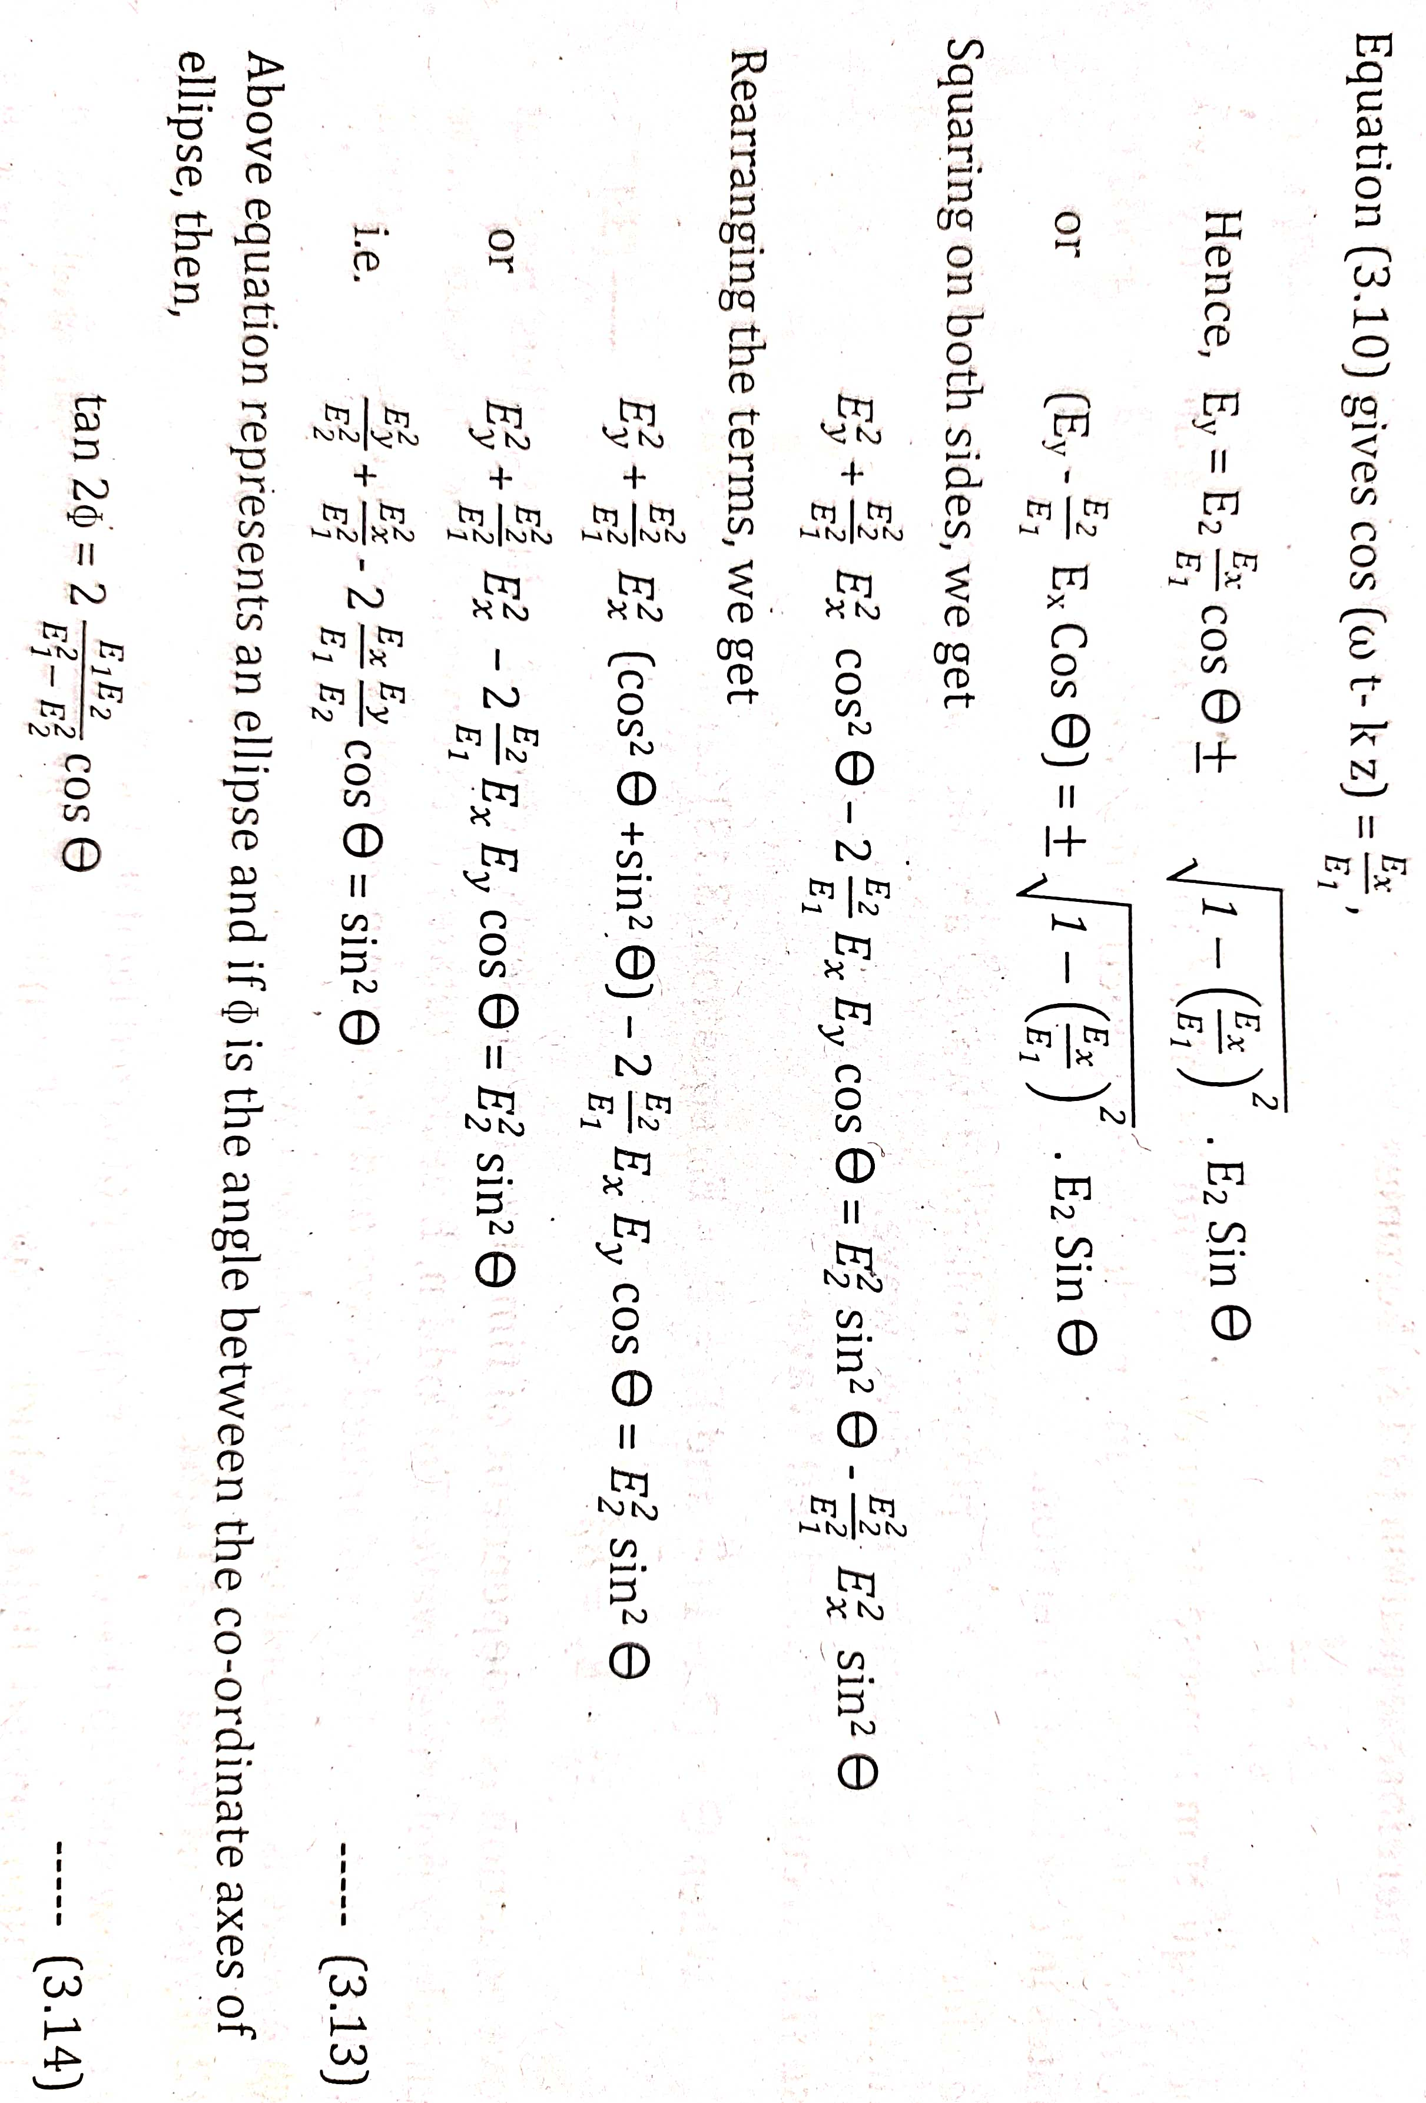

Slide 55
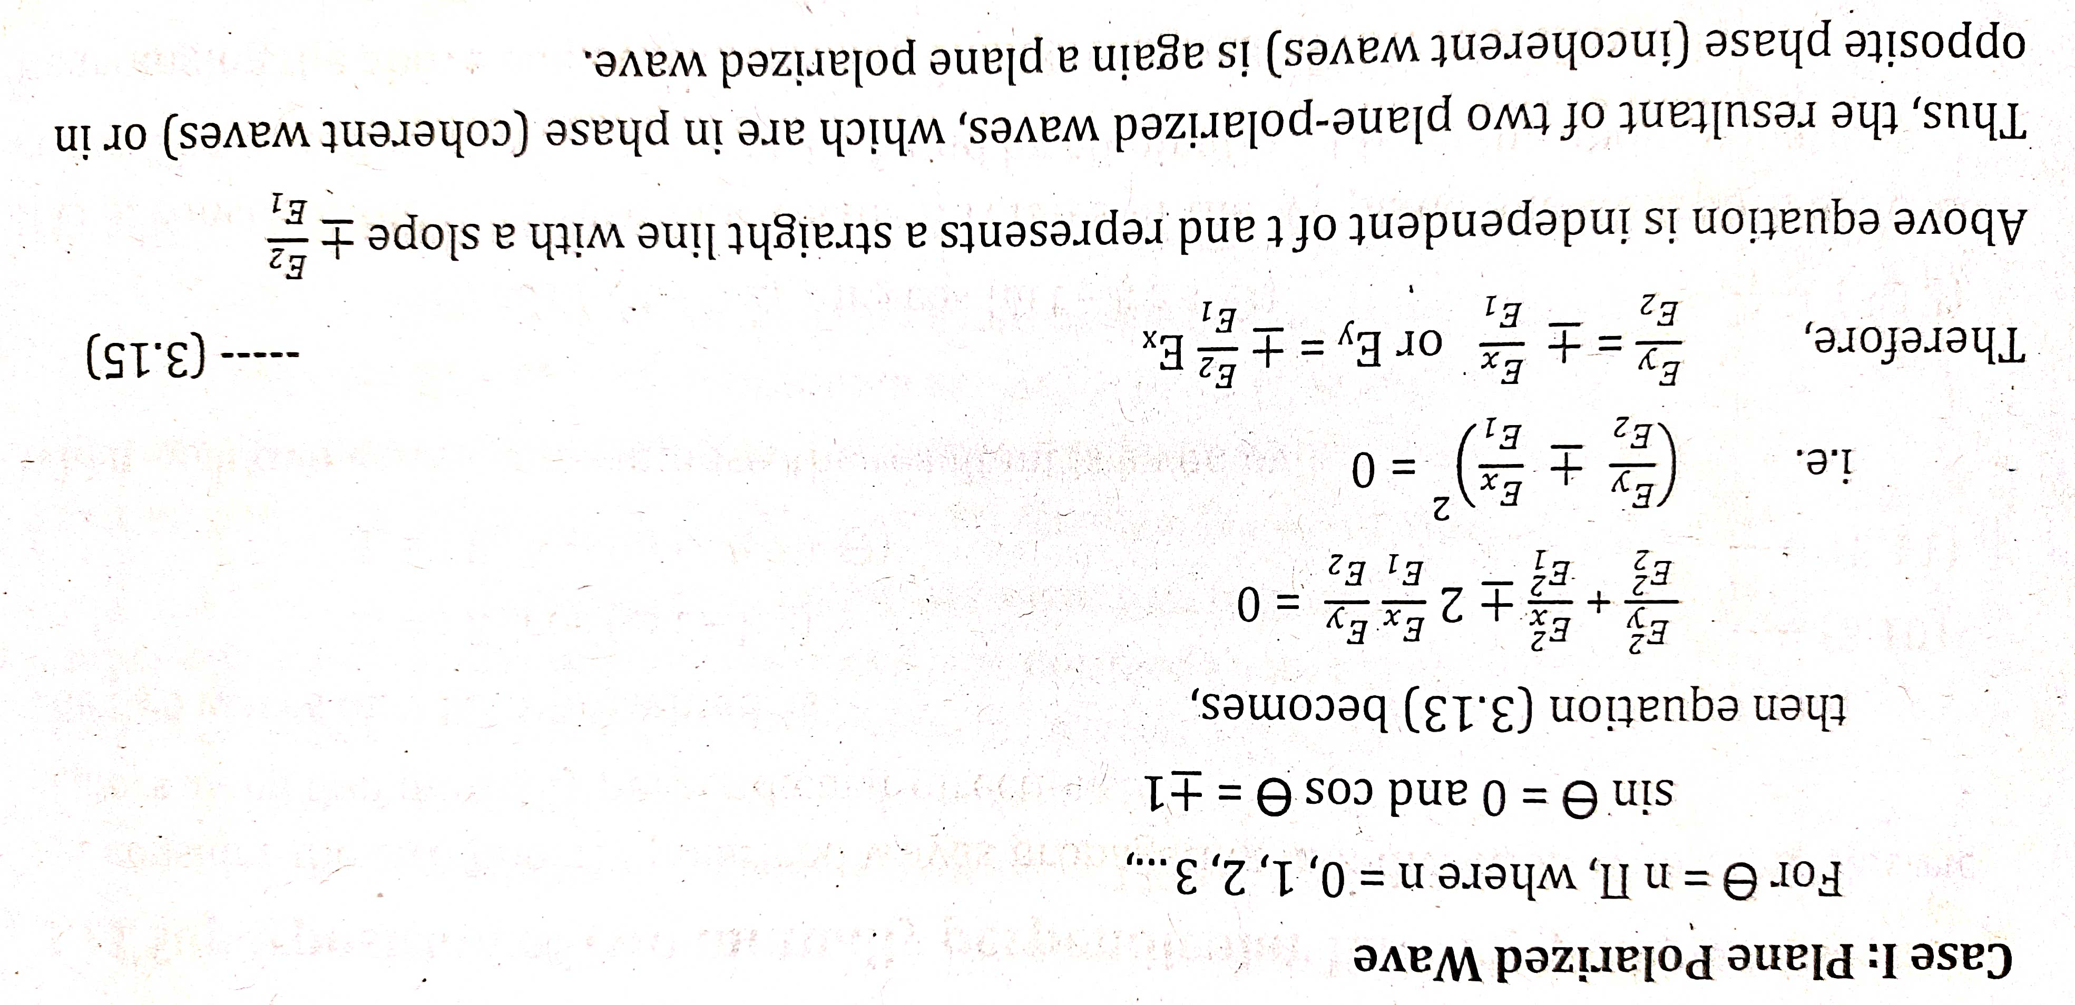

Slide 56
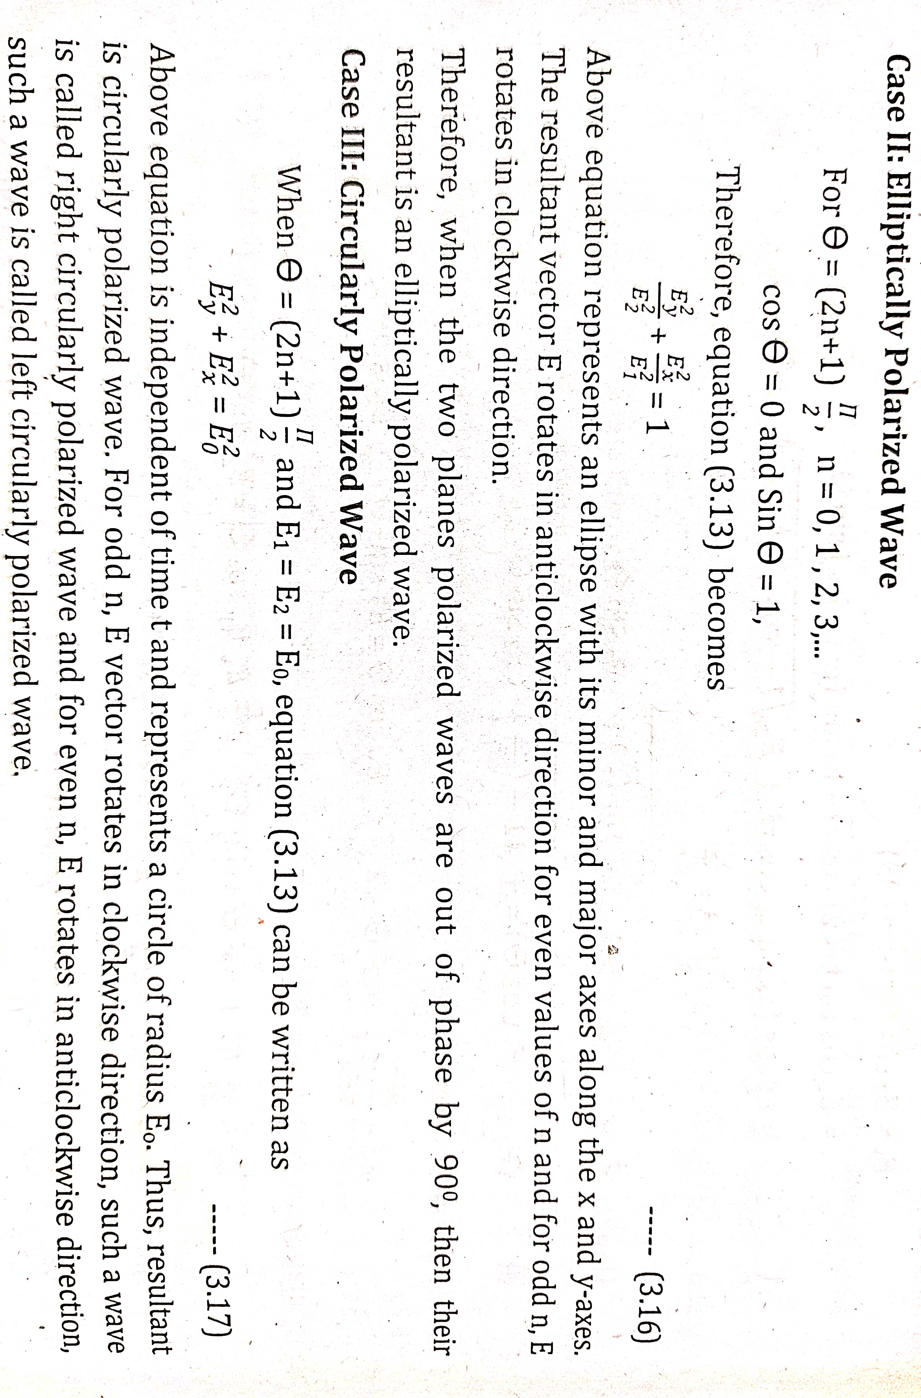

Slide 57
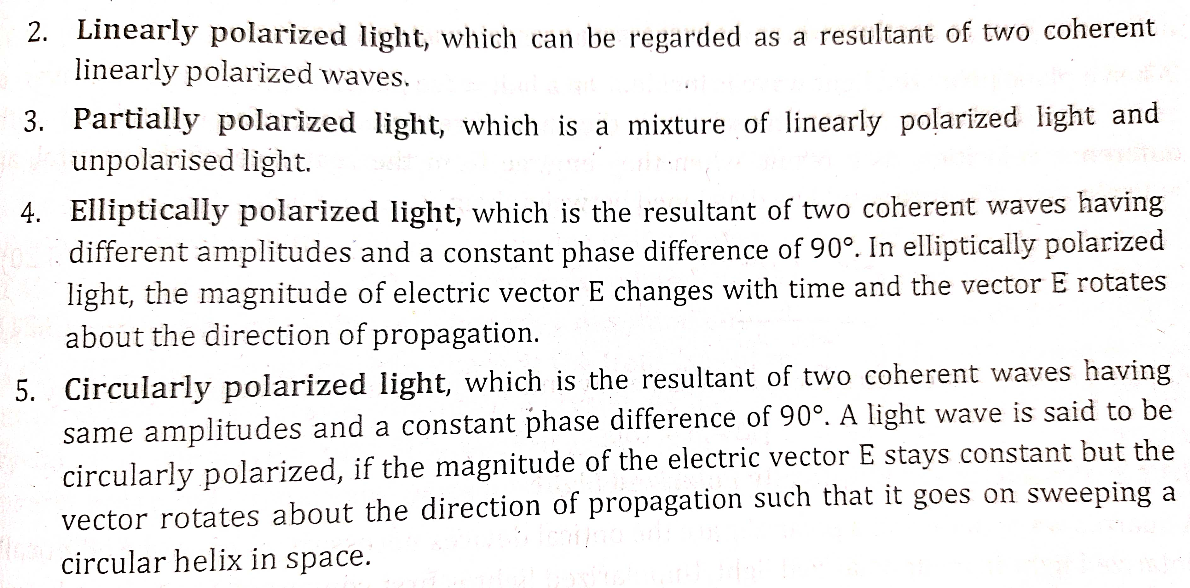

Slide 58
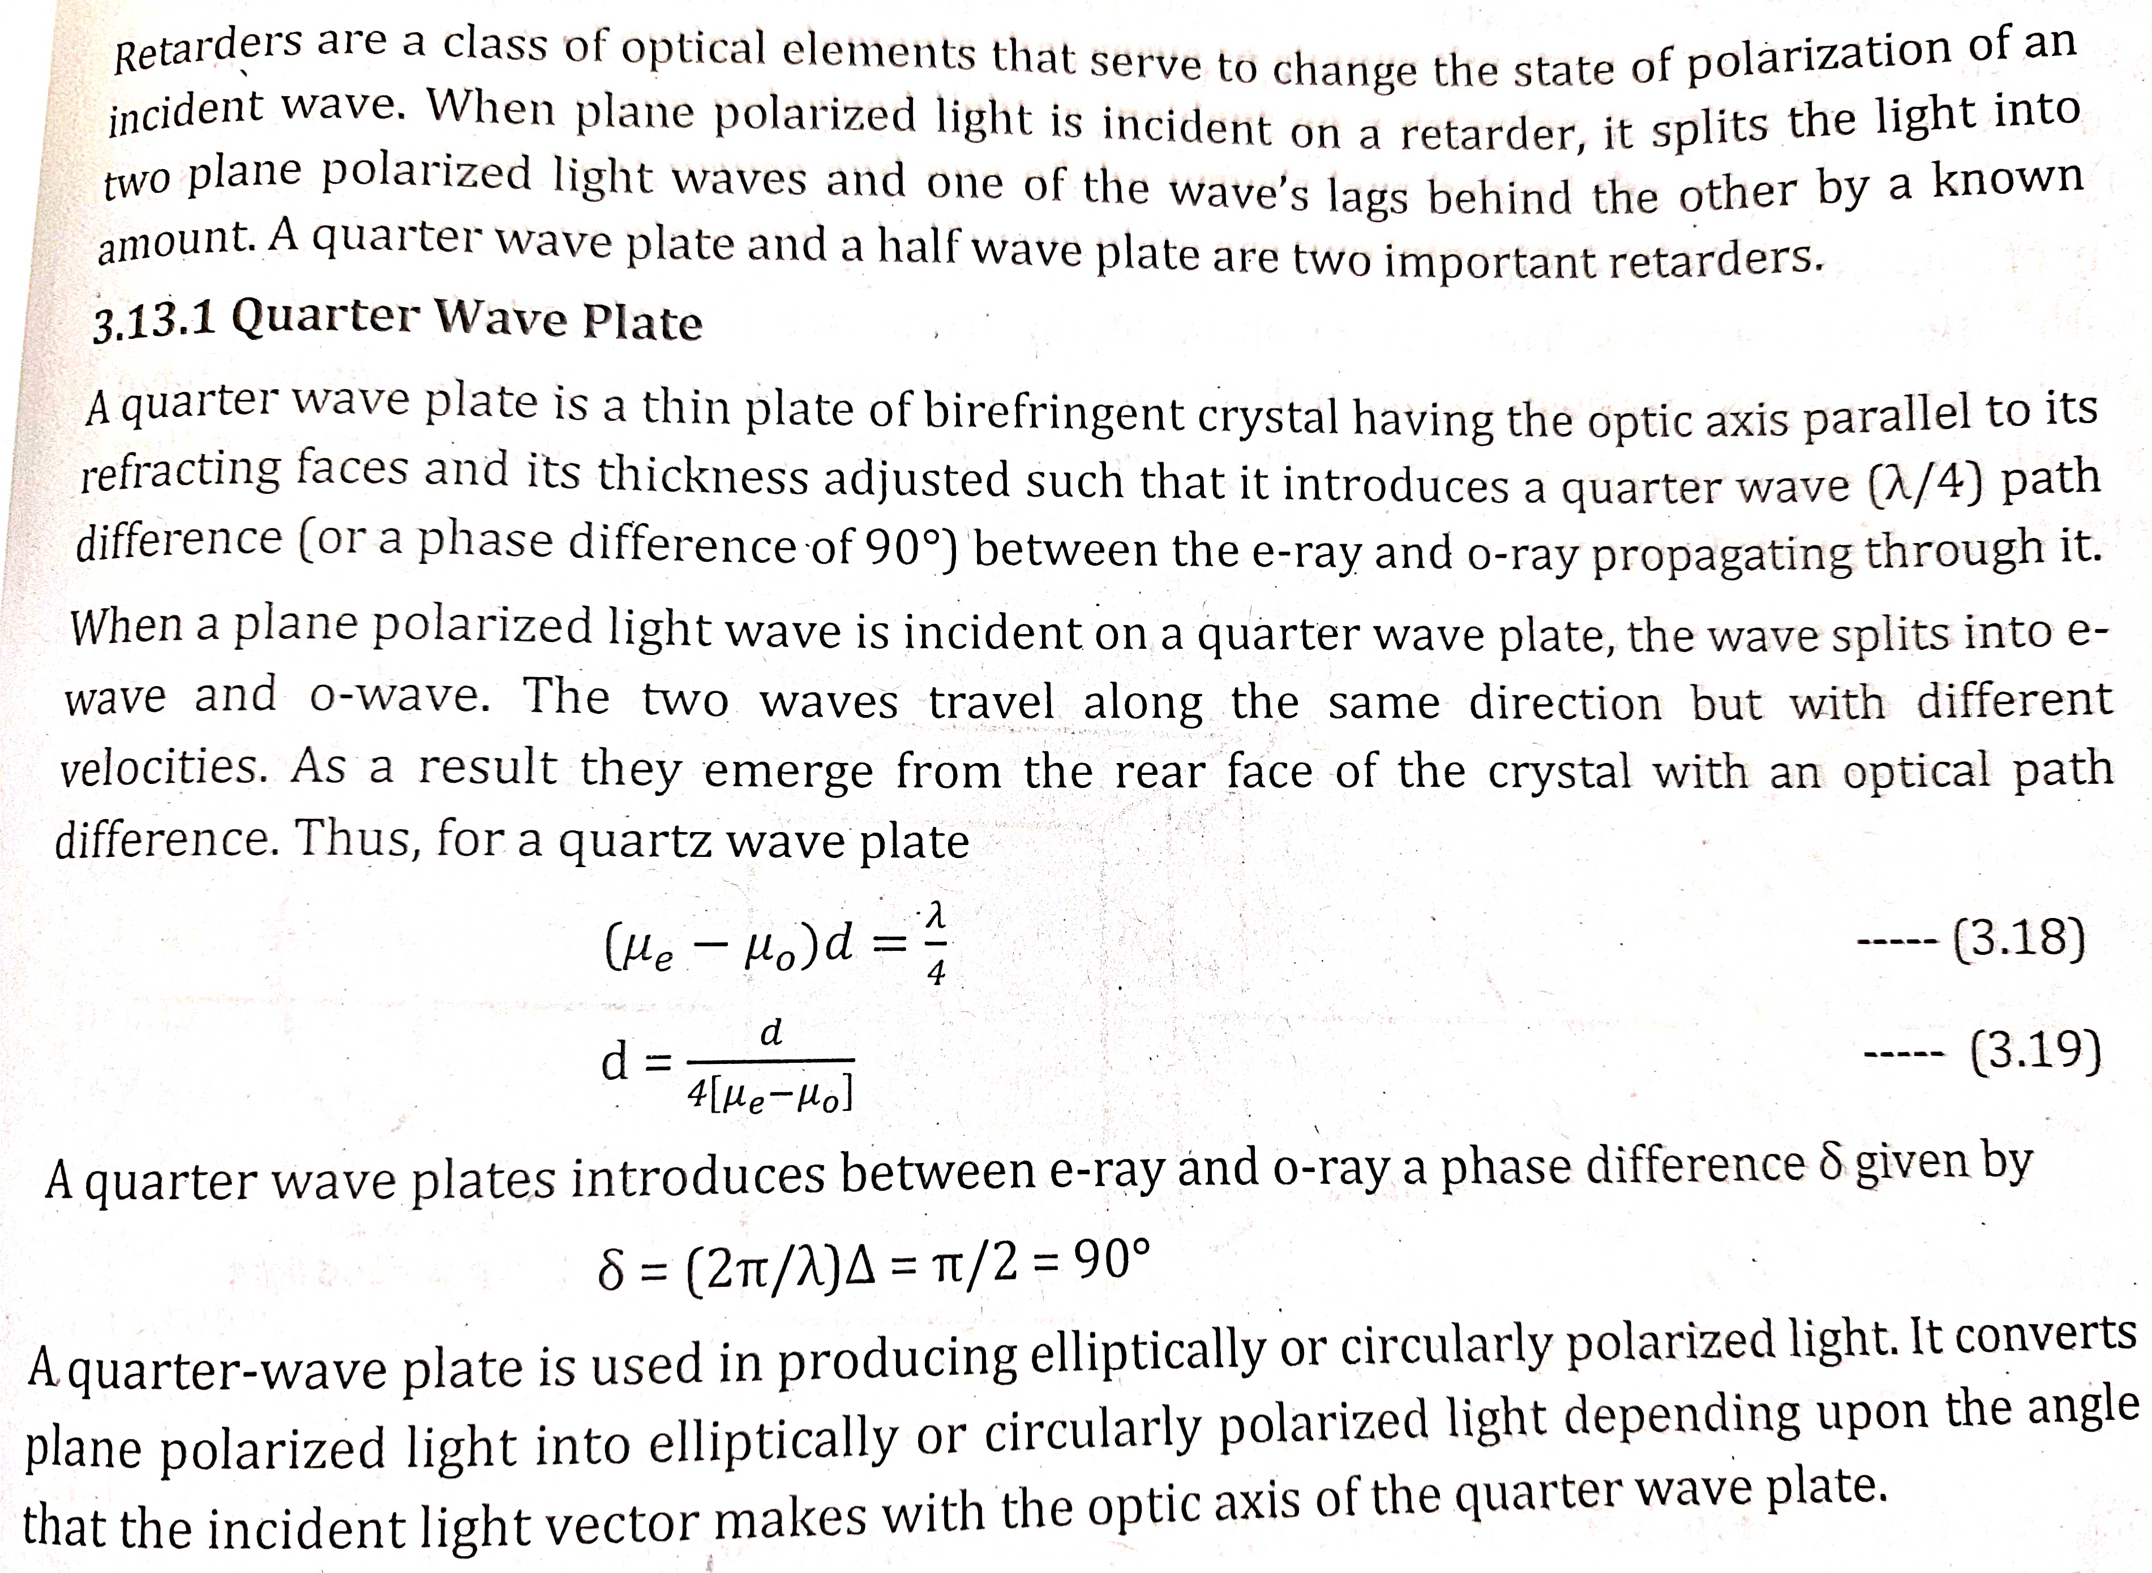
Retarders or Wave Plates

Slide 59
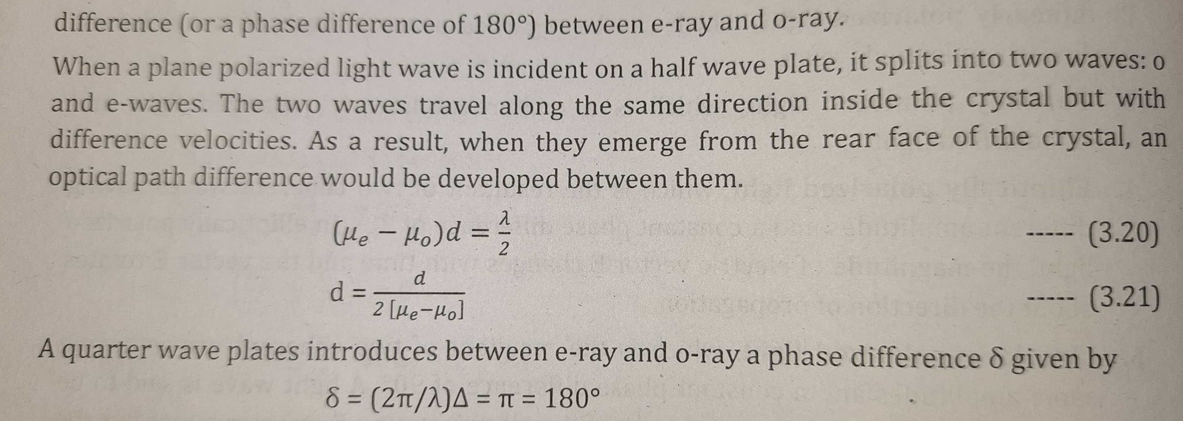

Slide 60
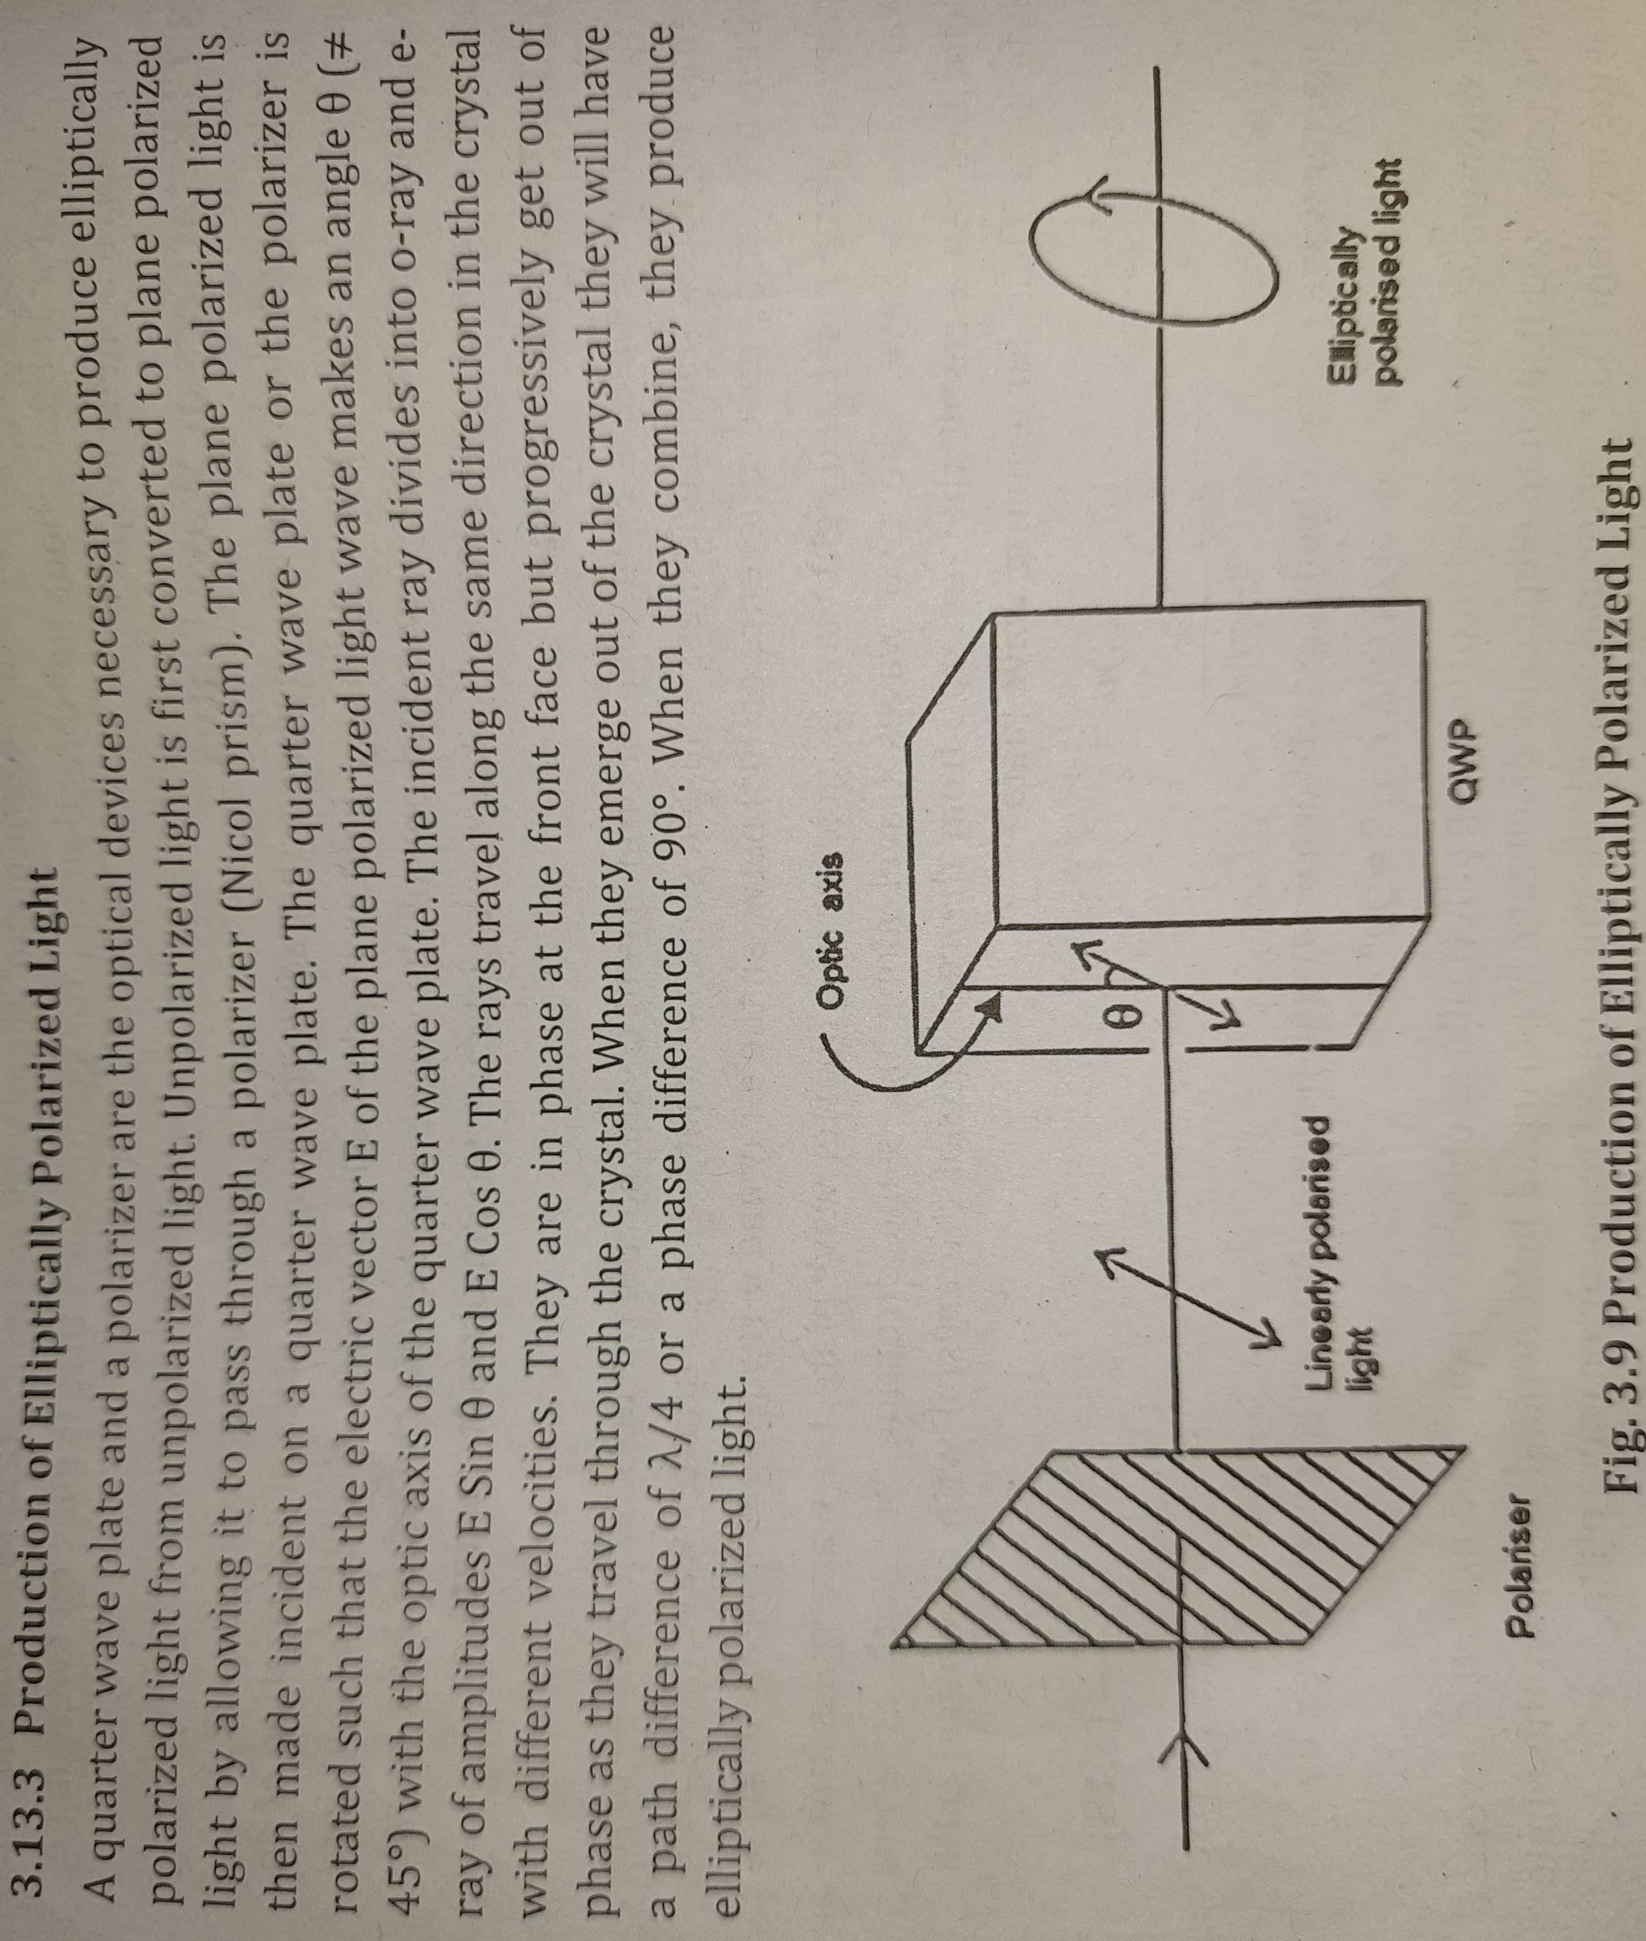

Slide 61
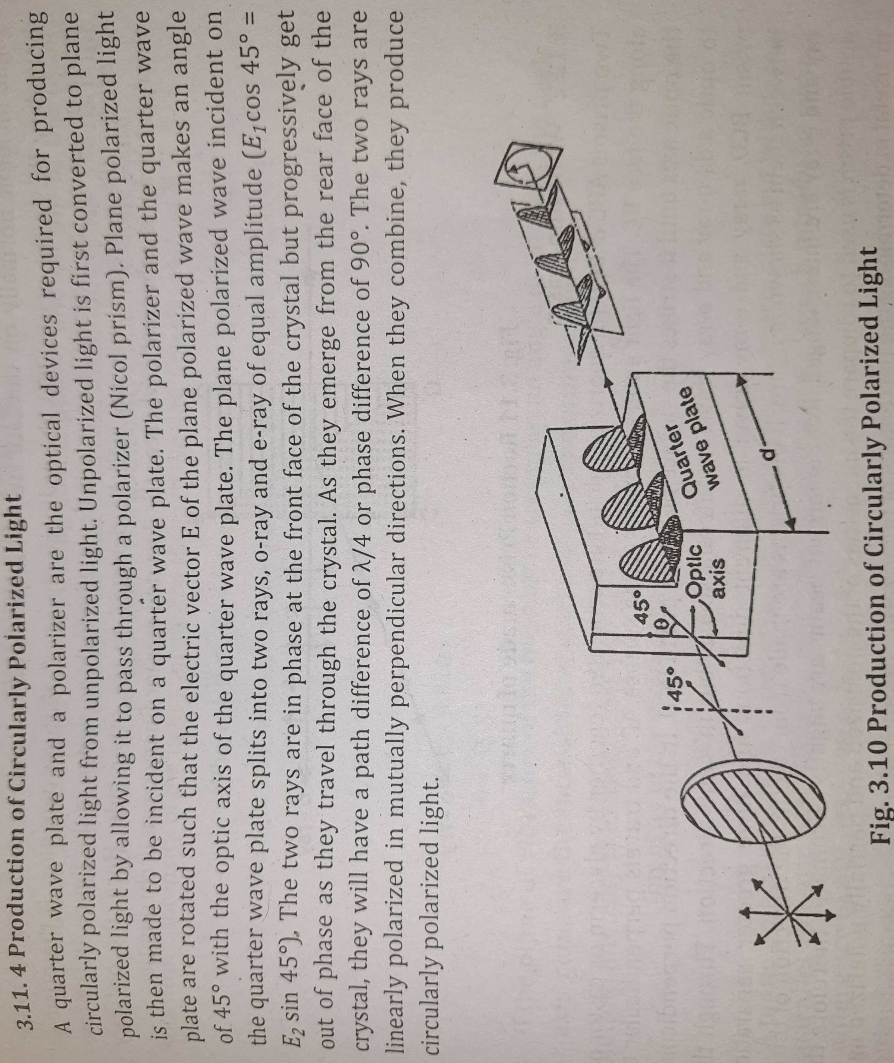

Slide 62
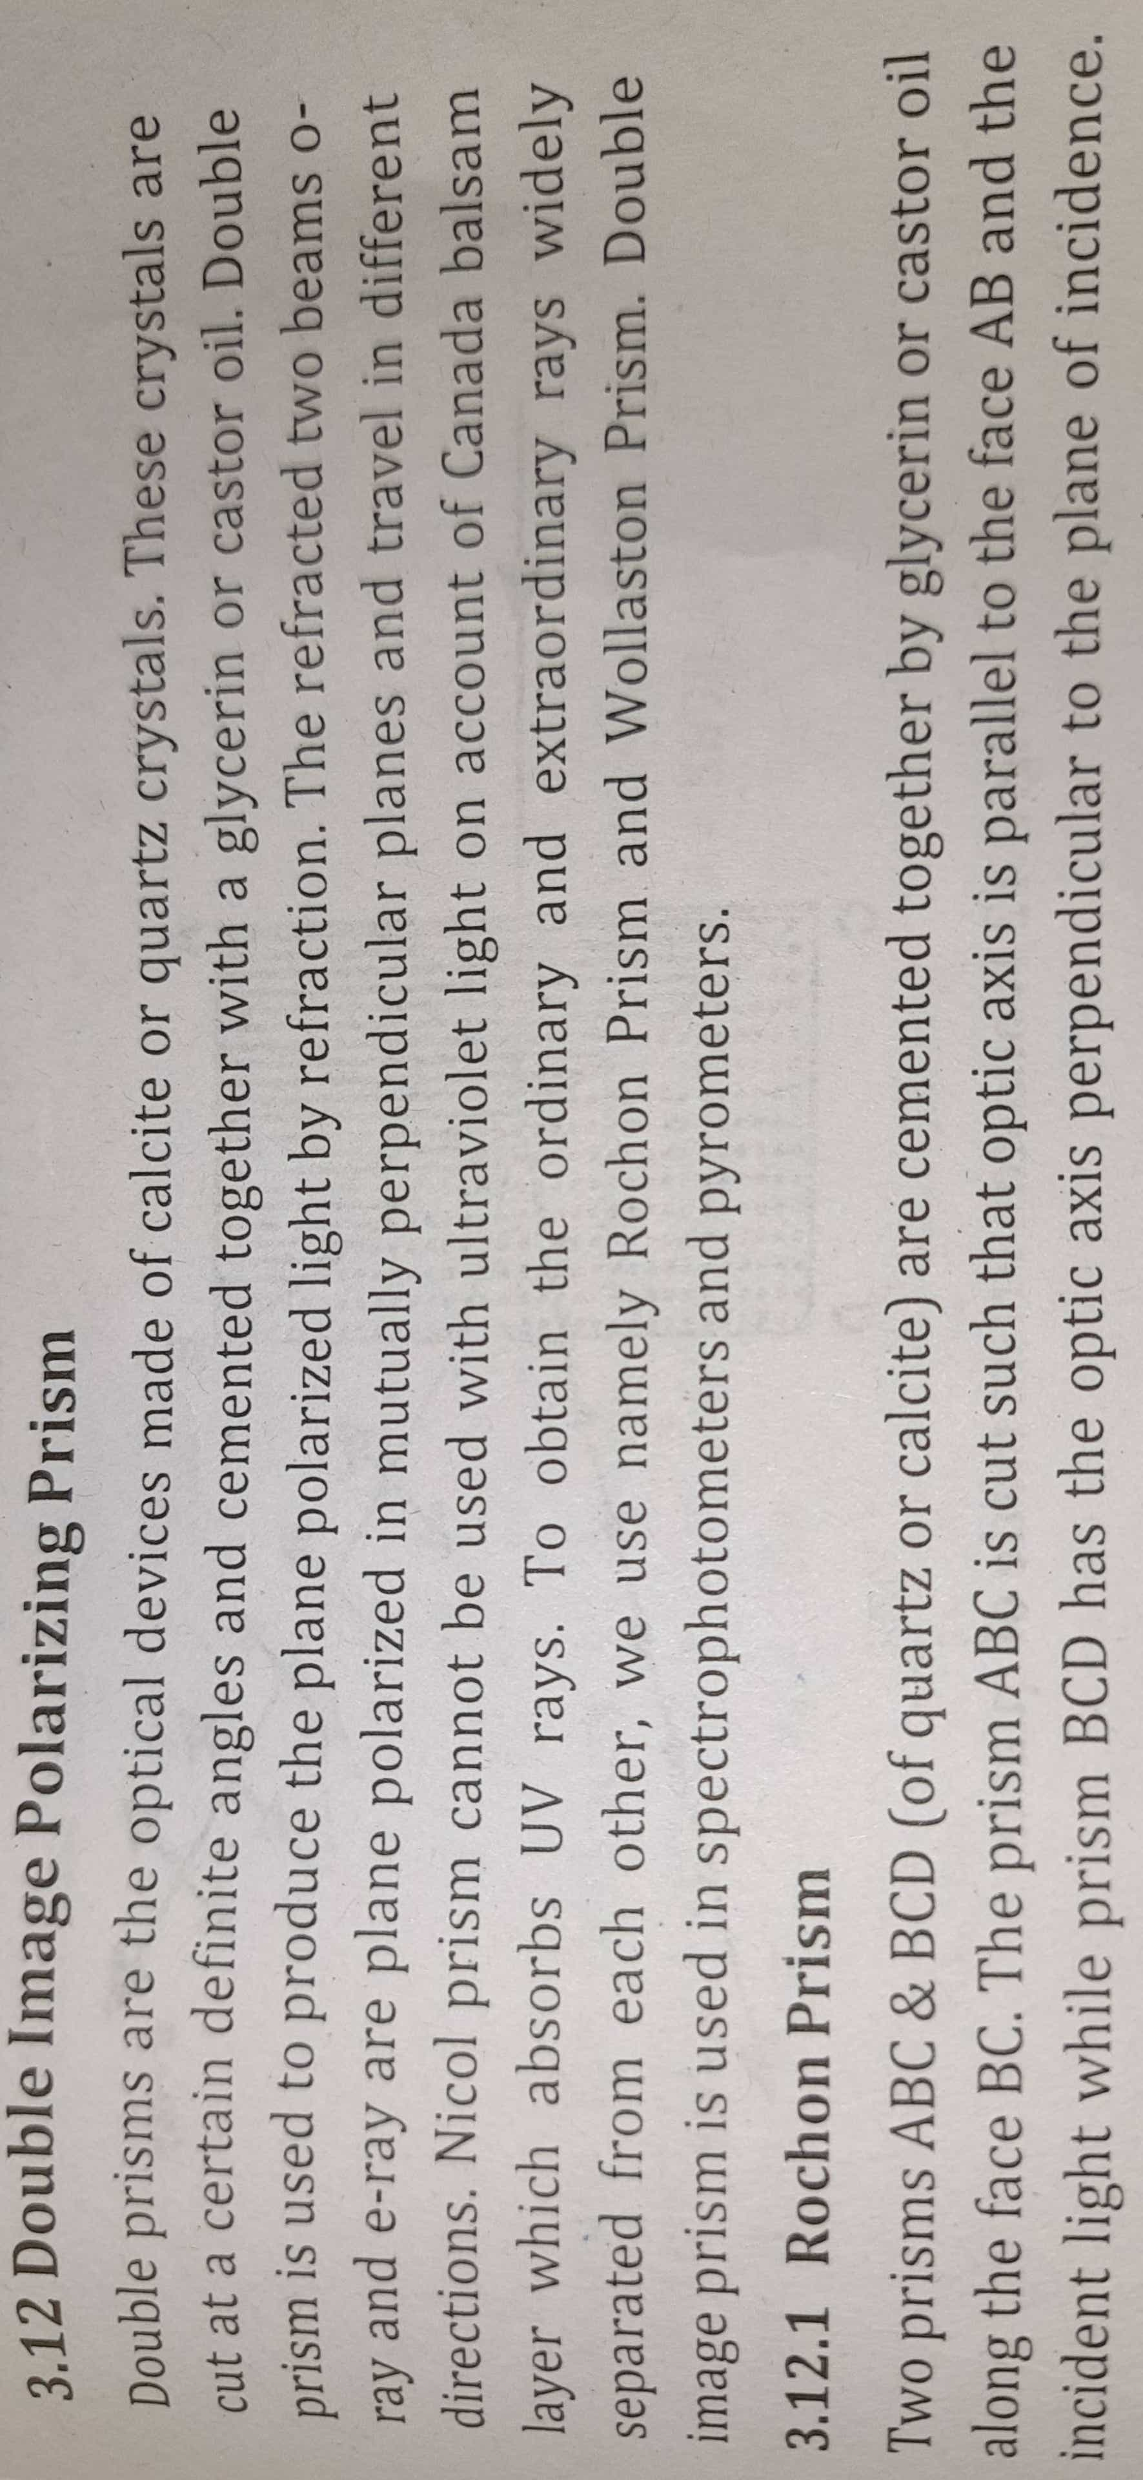
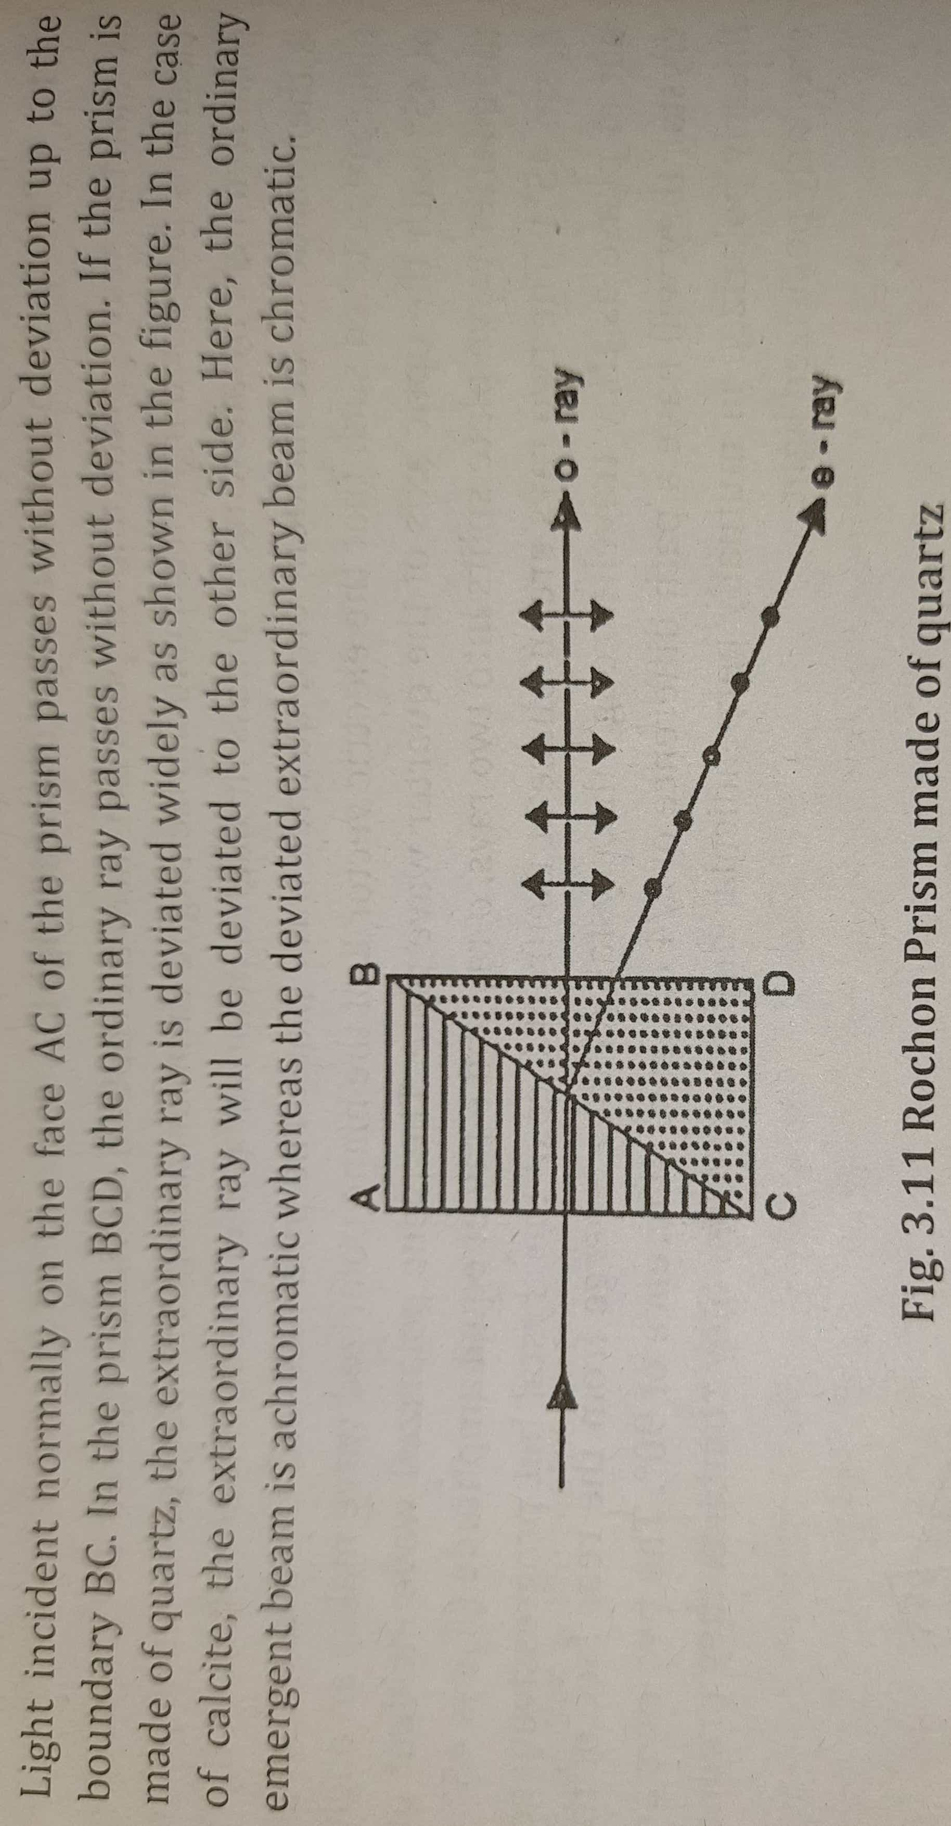

Slide 63
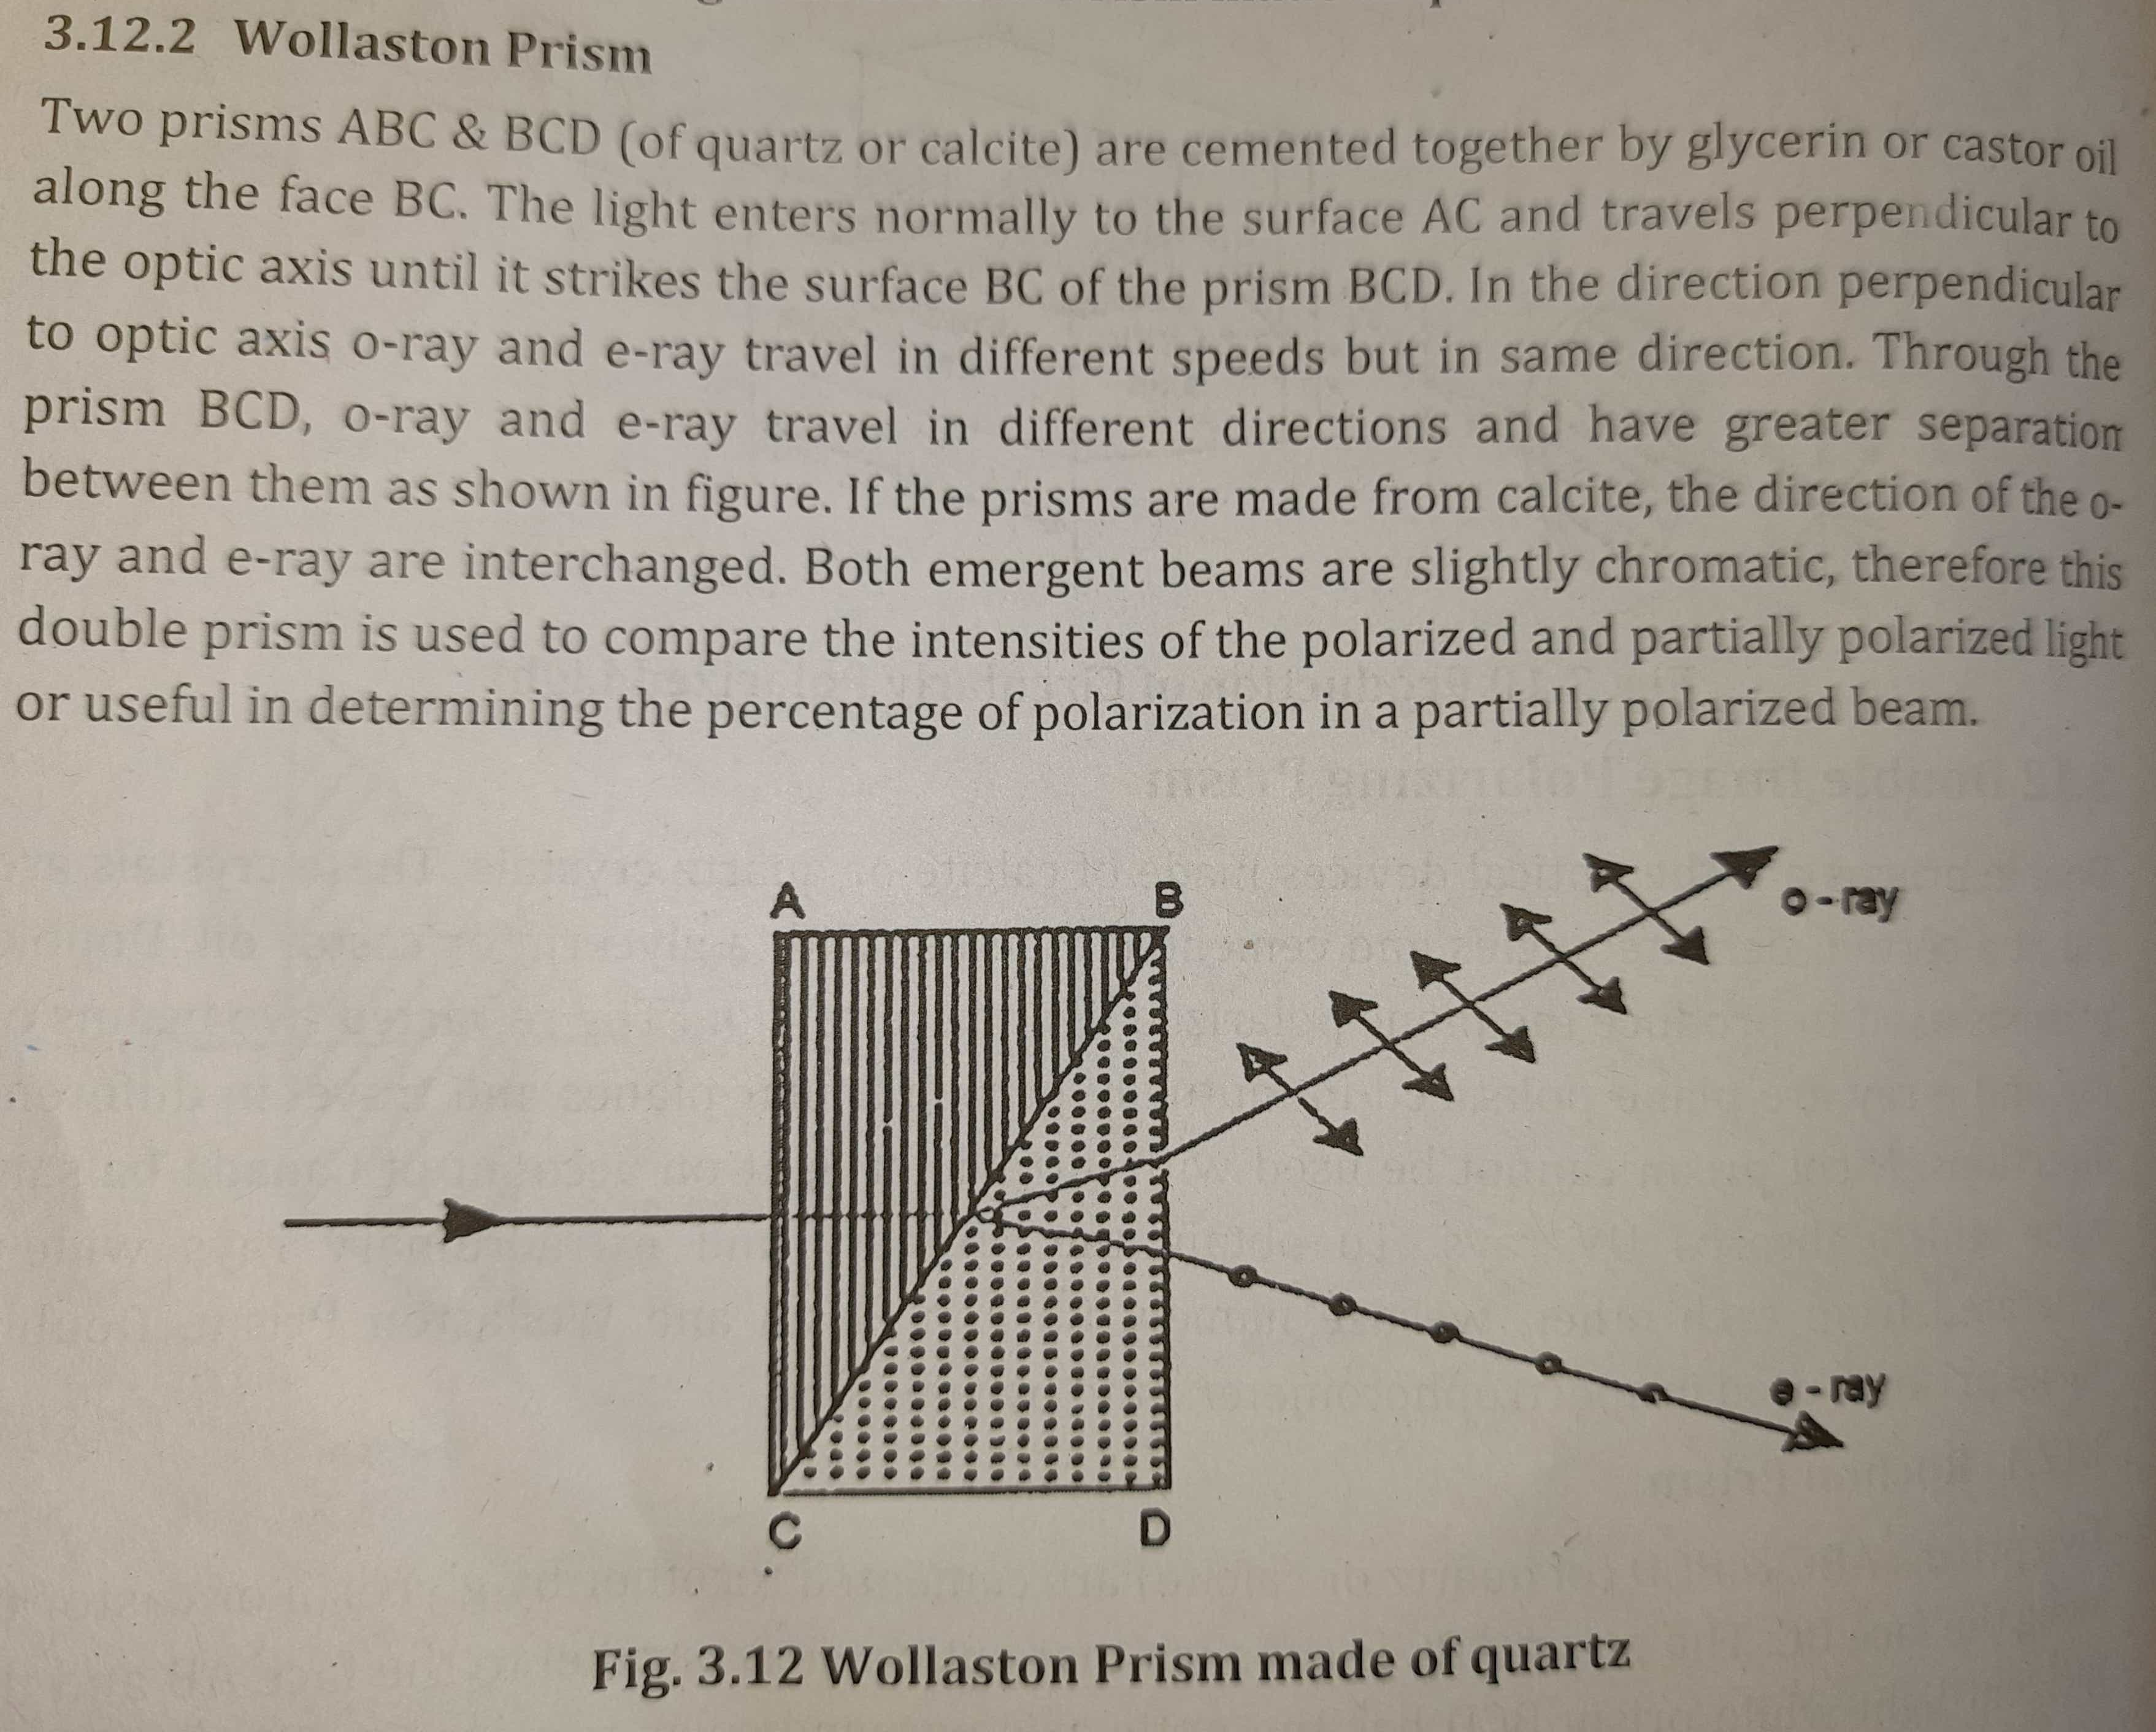

Slide 64
